Slide 1
ATLAS to MetagenomeScope: Visualizing Metagenome Assembly Graphs
Todd J Treangen
Assistant Professor
Department of Computer Science – Rice University

Slide 2
Ready, set, download!
First:
./Chiron/bin/metacompass_interactive
python3 /opt/MetaCompass/go_metacompass.py
Second:
cd /output
wget https://osf.io/xwk7m/download
wget https://osf.io/6dmh5/download
Third:
wget http://tiny.cc/l65faz
wget http://tiny.cc/sa6faz

Slide 3
Docker details
Where do I save my output?
/output
How do I exit the container?
exit
How do I access my output after exiting the container?
cd /home/stamps19/chiron/metacompass

Slide 4
Acknowledgements
Mihai Pop (UMD): Metagenomics!
Marcus Fedarko (UCSD): MetagenomeScope
Victoria Cepeda (UMD): MetaCompass
Jay Ghurye (Dovetail Genomics): MetaCarvel

Slide 5
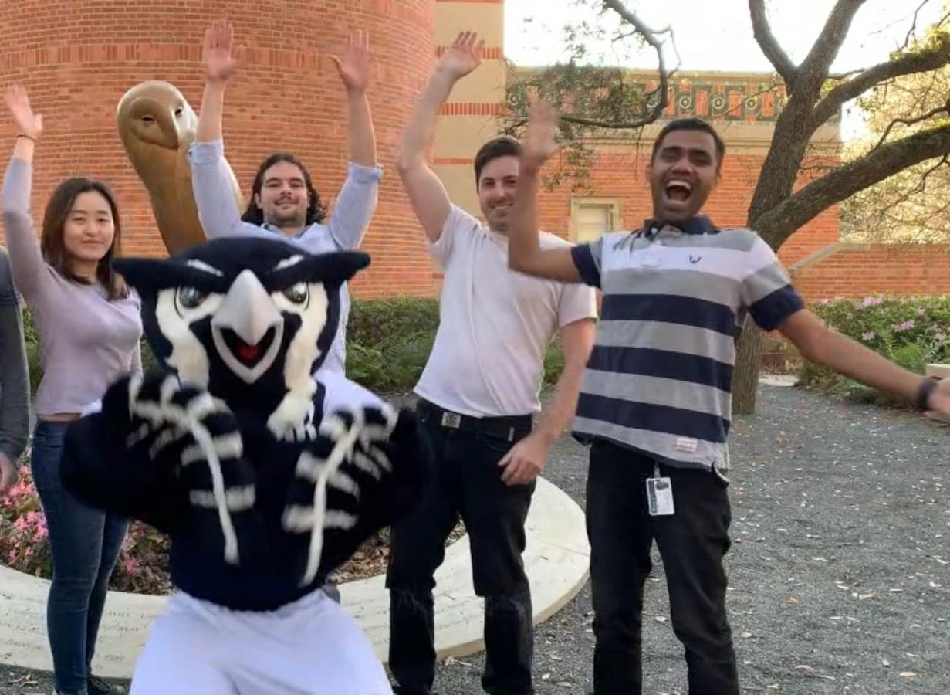
Treangen Lab Members @Rice (Houston, TX)
Dreycey Albin
Leo Elworth
Advait Balaji
Qi Wang
Me?

Slide 6
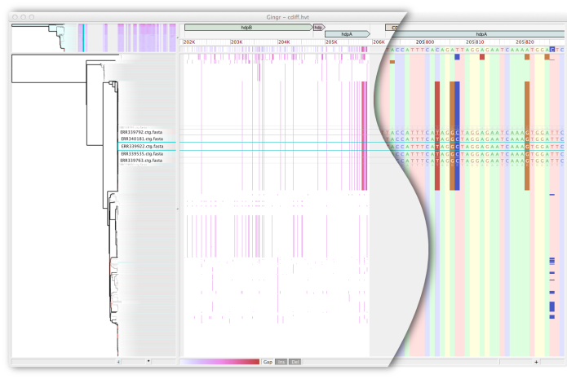
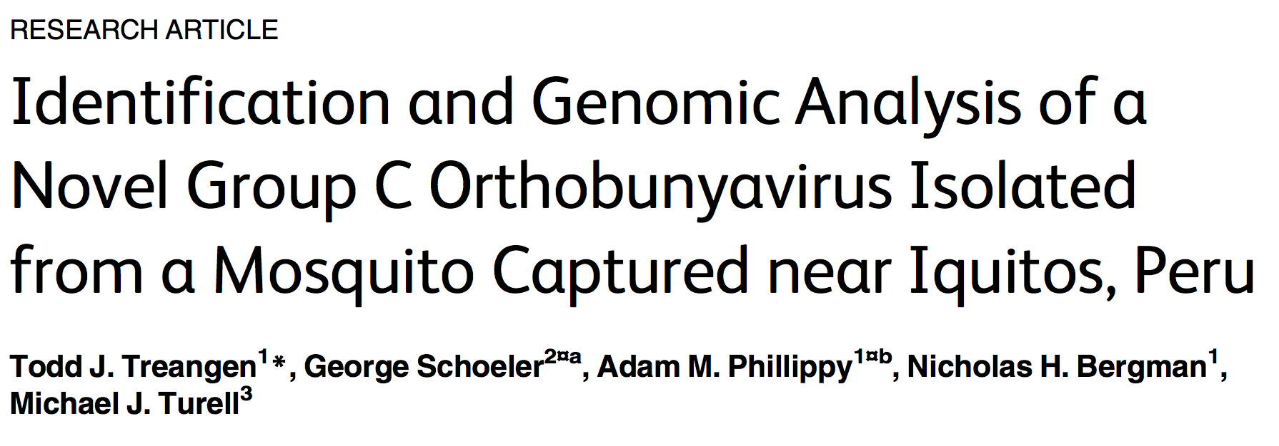

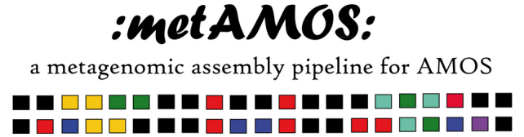

Research background/interests
Pathogen Detection
Software Engineering
Microbial Ecology & Evolution
Bioinformatics

Slide 7
Goals for a metagenomic assembler
Must work well for clonal data
handle repeats
handle errors
deal with low coverage regions
Must deal with polymorphisms
distinguish between errors and polymorphisms
– distinguish between repeats and polymorphisms
– enable discovery of polymorphisms/variation

Slide 8
Repeats in metagenome
High coverage regions -> abundant organisms
Repeats are genome sized due to closely related strains in the sample
Isolate genome
Metagenome
Species 1
Species 2
Species 3
Notes:
Although the statistical methods seem to work well in single genome assembly, they can not be applied to metagenome assembly. Metagenome consists of a mixture of organisms. So if some organism is more abundant in the sample, it will have higher coverage despite of not being a repeat. By removing such regions, a valuable information is lost. Also, repeats are very large in length in metagenome due to closely related strains in the sample. For example, in this figure, regions marked by green are repetitive regions. In case of isolate genome, repeats are small in length but in case of metagenome, repeats are much larger in length. We do not want to remove such regions as it would result in loss of valuable information while reconstruction of genomes.

Slide 9
Why assemblers break contigs?
Genome
Reads
Contigs
Not enough coverage to assemble!

Slide 10
Why assemblers break contigs?
Genome
Contig 2
?
Contig 1
?
Contig 3

Slide 11
Example 1: AAAAAAAAAAAA (no unique 3-mer)
4bp reads:
(1) AAAA, (2) AAAA, (3) AAAA, (4) AAAA, (5) AAAA, (6) AAAA, (7) AAAA, (8) AAAA, (9) AAAA
3-mers:
AAA
Overlaps:
(1)->(2),(1)->(3),(1)->(4),(1)->(5),(1)->(6),(1)->(7),(1)->8,(1)->(9)
(2)->(1),(2)->(3),(2)->(4),(2)->(5),(2)->(6),(2)->(7),(2)->8,(2)->(9)
….
(9)->(1),(9)->(2),(9)->(3),(9)->(4),(9)->(5),(9)->(6),(9)->(7),(9)->(8)

Slide 12
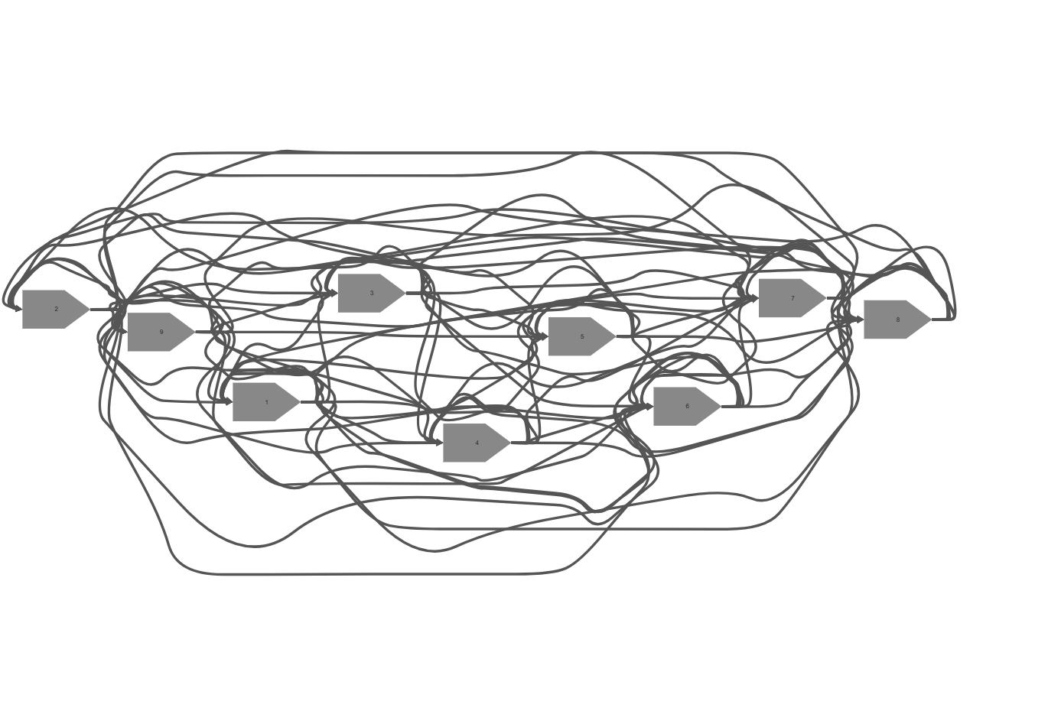
Slide credits: MetagenomeScope

Slide 13
Example 2: AATCCGTTCGGA (no 3-mer repeats)
4bp reads:
(1) AATC, (2) ATCC, (3) TCCG, (4) CCGT, (5) CGTT, (6) GTTC, (7) TTCG, (8) TCGG, (9) CGGA
3-mers (10)
(i) AAT, (ii) ATC, (iii) TCC, (iv) CCG, (v) CGT, (vi) GTT, (vii) TTC, (viii) TCG, (ix) CGG, (x) GGA
Overlaps
(1)->(2)
(2)->(3)
(3)->(4)
(4)->(5)
(5)->(6)
(6)->(7)
(7)->(8)
(8)->(9)

Slide 14
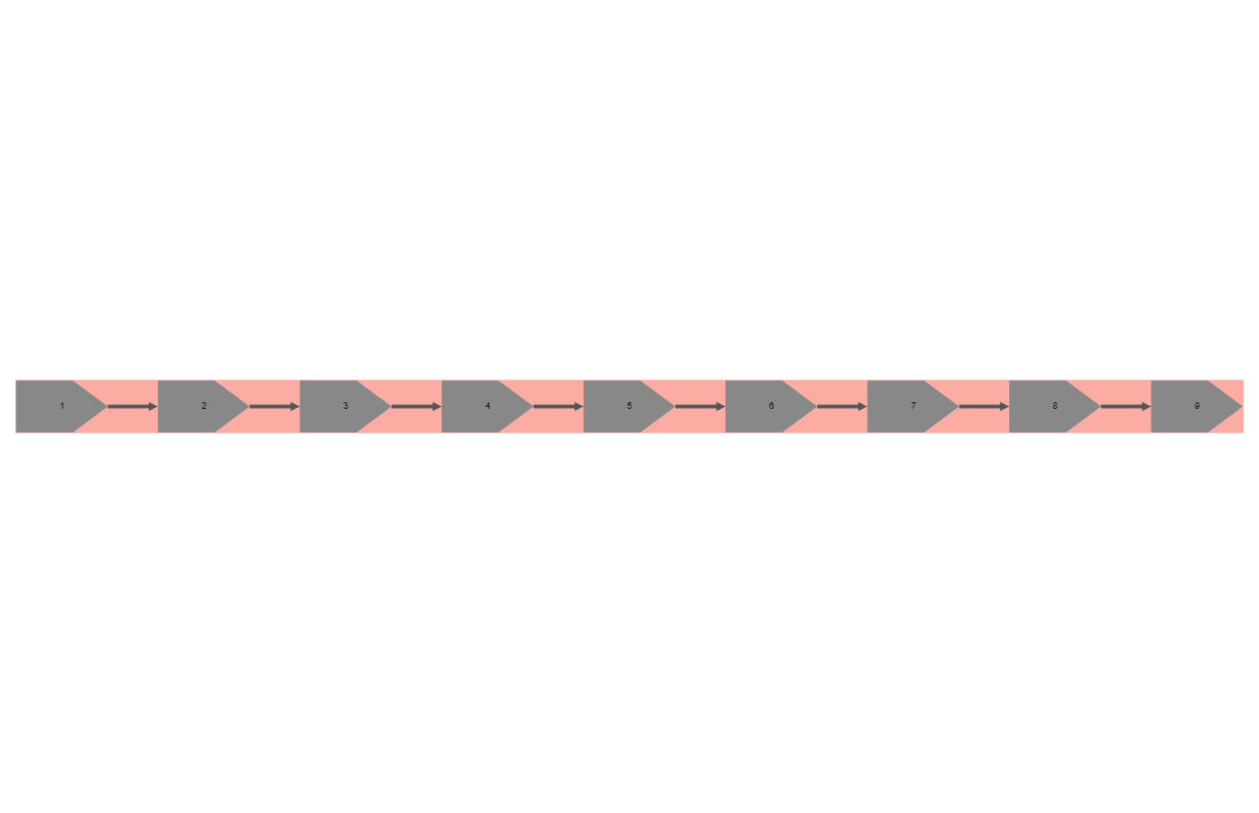
Slide credits: MetagenomeScope

Slide 15
AATCCGTTCGGA
AATC
ATCC
TCCG
CCGT
CGTT
GTTC
TTCG
TCGG
CGGA

Slide 16
Example 3: AATCCGTTCGGA (sequencing error)
4bp reads:
(1) AATG, (2) ATCC, (3) TCCG, (4) CCGA, (5) CGTT, (6) GTTC, (7) TTCG, (8) TCGG, (9) CGGA
3-mers (10)
(i) AAT, (ii) ATC, (iii) TCC, (iv) CCG, (v) ATG, (vi) CGT, (vii) GTT, (viii) TTC, (xi) TCG, (x) CGG, (xi) GGA
Overlaps
(1)->(2)
(2)->(3)
(3)->(4)
(4)->(5)
(5)->(6)
(6)->(7)
(7)->(8)
(8)->(9)

Slide 17
ATCCGTTCGGA
ATCC
TCCG
CCGT
CGTT
GTTC
TTCG
TCGG
CGGA

Slide 18
Example 4: AATCCGTTCGGA (sequencing error)
4bp reads:
(1) AATC, (2) ATCC, (3) TCCG, (4) CCGT, (5) CGTT, (6) GTTC, (7) TTCC, (8) TCGG, (9) CGGA
3-mers (10)
(i) AAT, (ii) ATC, (iii) TCC (X2), (iv) CCG, (v) CGT, (vi) GTT, (vii) TTC, (viii) TCG, (ix) CGG, (x) GGA
Overlaps
(1)->(2)
(2)->(3)
(3)->(4)
(4)->(5)
(5)->(6)
(6)->(7)
(7)->(8)
(7)->(3)
(8)->(9)

Slide 19
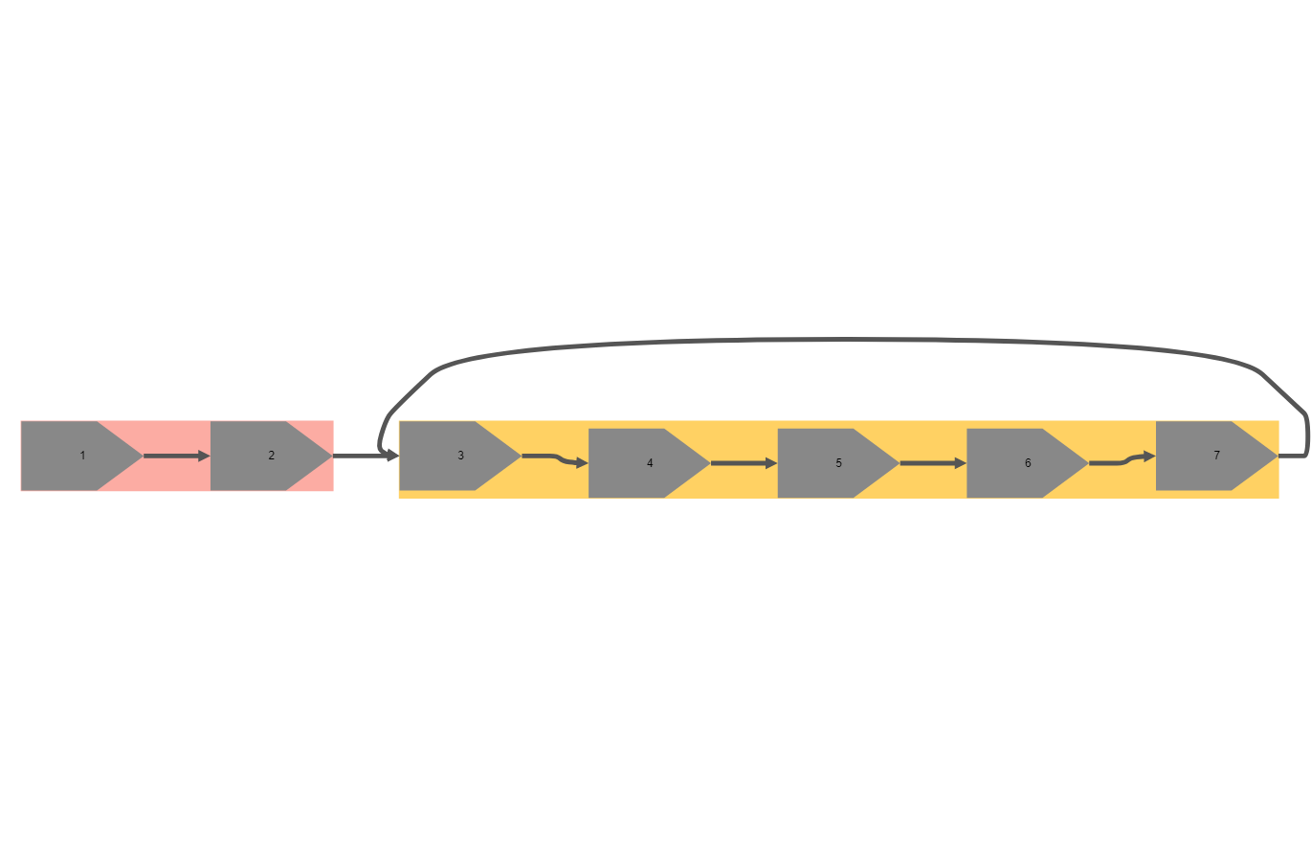
Slide credits: MetagenomeScope

Slide 20
Example 5: AATCCGTTCGGA (coverage gap)
4bp reads:
(1) AATC, (2) ATCC, (3) TCCG, (4) CCGT, (5) CGTT, (6) GTTC, (7) TTCG, (8) TCGG, (9) CGGA
3-mers (10)
(i) AAT, (ii) ATC, (iii) TCC, (iv) CCG, (v) TTC, (vi) TCG, (vii) CGG, (viii) GGA
Overlaps
(1)->(2)
(2)->(3)
(3)->(4)
(4)->(5)
(5)->(6)
(6)->(7)
(7)->(8)
(8)->(9)

Slide 21
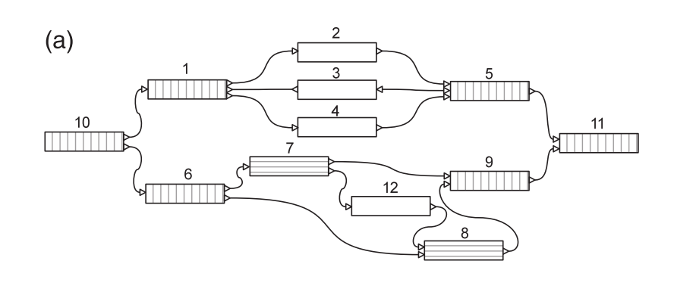
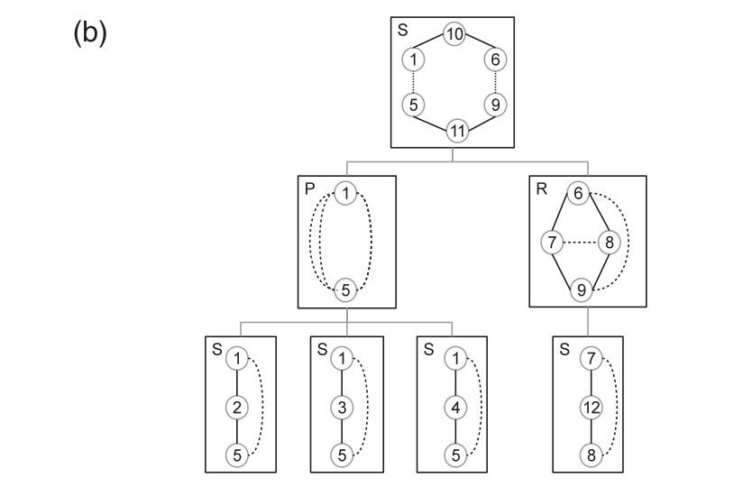
Variant Detection Using Graph Topology
SPQR Tree
If two nodes lie in the same node of SPQR tree and share a virtual edge, then they are start and end of a bubble!
Figure credits: Nijkamp et al., 2013

Slide 22
Variant detection using graph topology
Species 1
…AACTTACGTGAAAATACAACTTAGGACTA…
Variations in the sequences cause bubble in the graph
Naïve search for all bubble is exponential in the number of nodes
Use a SPQR tree based approach to find out bubbles (Nijkamp et al. 2013)
Runs in O(V+E) time (Gutwenger et al. 2001)
Species 2
…AACTTACTTGAAAATACAACTTTGGACTA..
ACGTG
TTAGG
AACTT
AAAAT
ACAAC
GACTA
ACTTG
TTTGG

Slide 23
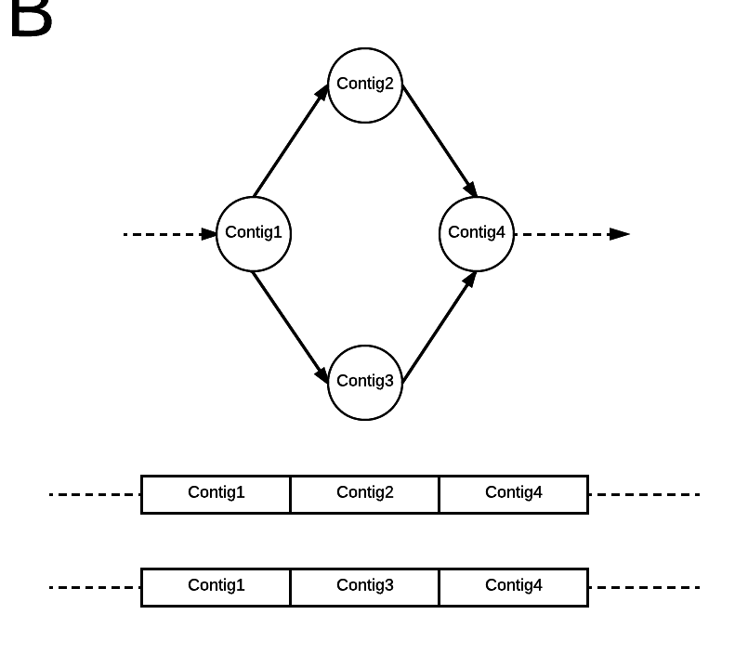

Slide 24
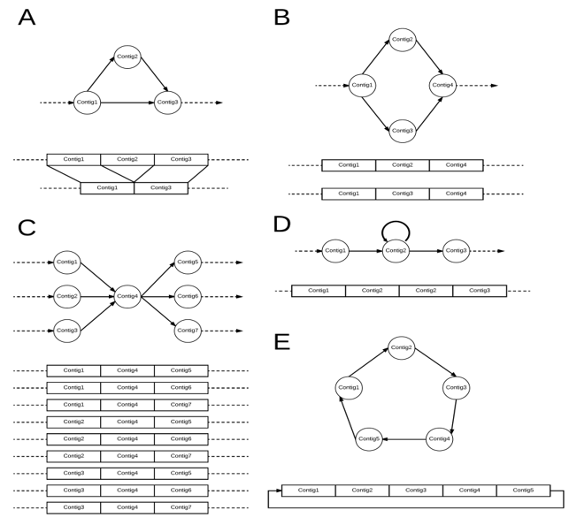
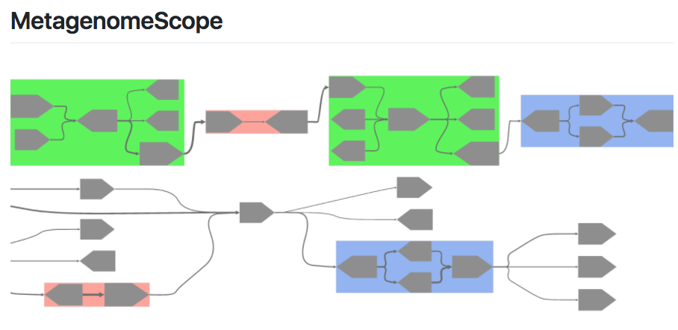
MetaCarvel and MetagenomeScope
Overview of the different types of variants detected by MetaCarvel.
​
We focus on five types of variants:​
A) Triangular bubbles,​
B) Simple four bubbles ​
C) High centrality nodes​
D) Simple Cycles, and ​
E) Multinode cycles
https://github.com/marbl/MetaCarvel
https://github.com/marbl/MetagenomeScope

Slide 25
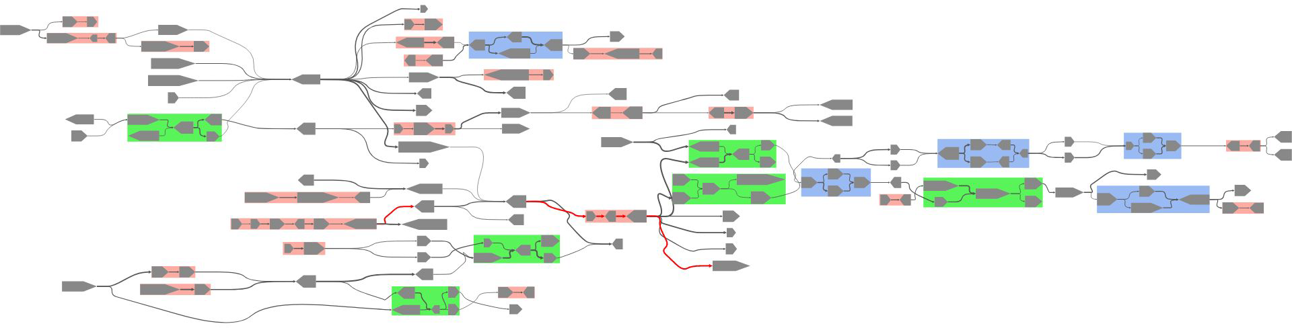
Assembly Graphs
(Meta)genome assembly can be represented as a graph traversal

Slide 26
Assembly Graphs
(either a de Bruijn graph or an overlap graph)
(Meta)genome assembly can be represented as a graph traversal

Slide 27
Assembly Graphs
(either a de Bruijn graph or an overlap graph)
(Meta)genome assembly can be represented as a graph traversal
In either case...

Slide 28
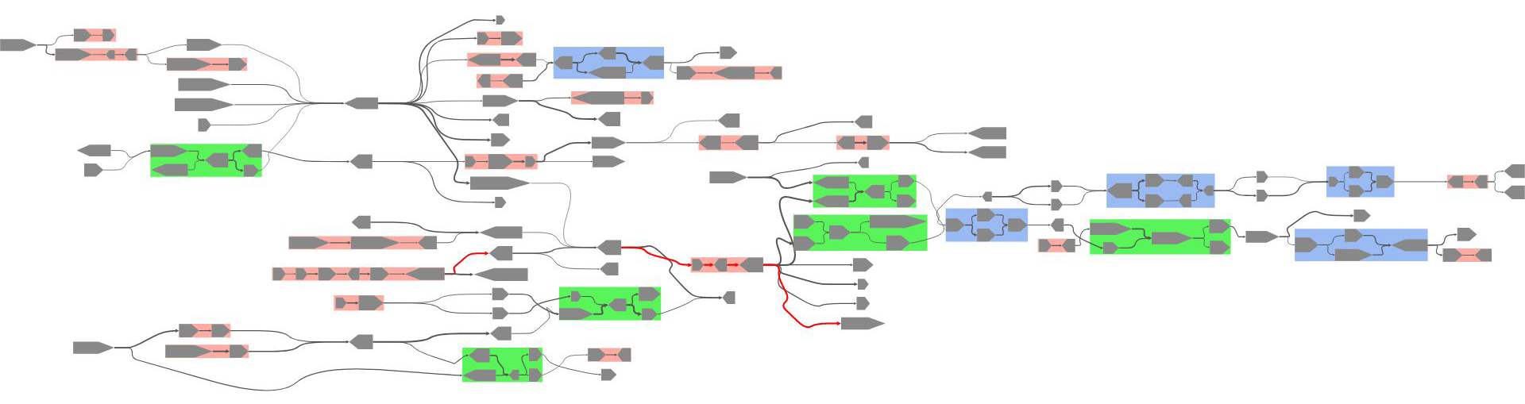
Assembly Graphs
(either a de Bruijn graph or an overlap graph)
(Meta)genome assembly can be represented as a graph traversal
Nodes (contigs) - fragments of DNA obtained from assembly
Edges - overlaps between contigs’ sequences
Largest connected component of an E. coli assembly graph produced with Velvet, visualized in MetagenomeScope

Slide 29
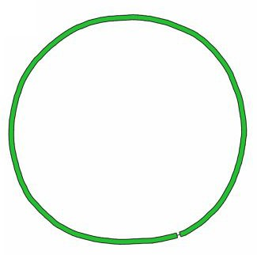
Assembly Graphs: The Good
Ideal genome assembly graph:
One node per sequence, maybe with an edge to itself
Ideal metagenome assembly graph:
c graphs, where each is an “ideal genome assembly graph” (assuming the input metagenome consists of c genomes)
These figures c/o the Bandage manuscript (Wick et al. 2015)

Slide 30
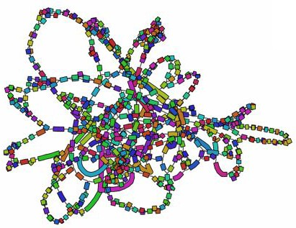
Assembly Graphs: The Bad /ugly
Actual genome assembly graph:
Lots of possible paths due to complexities like repeats, mutations, assembly errors, ...
Actual metagenome assembly graph:
More potential for these complexities to “compound” → even more fragmented
These figures c/o the Bandage manuscript (Wick et al. 2015)

Slide 31
Problem
How can we visualize metagenome assembly graphs in a way that highlights both
small-scale details, and
large-scale structure?

Slide 32
Your turn!
https://gitlab.com/treangen/stamps2019/README.md#part1

Slide 33
Exercise #1: Drawing Something
Open MetagenomeScope’s viewer interface at mgsc.umiacs.io.
Pick a demo assembly graph using the “Demo .db” button.
Draw one of the graph’s connected components¹!
¹ “Weakly” connected components

Slide 34
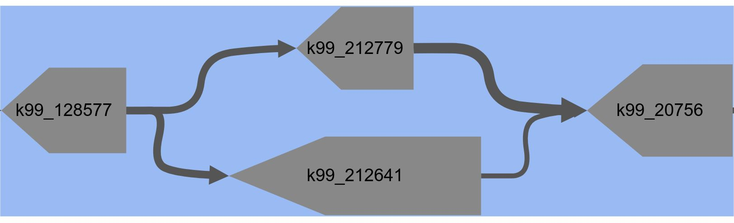
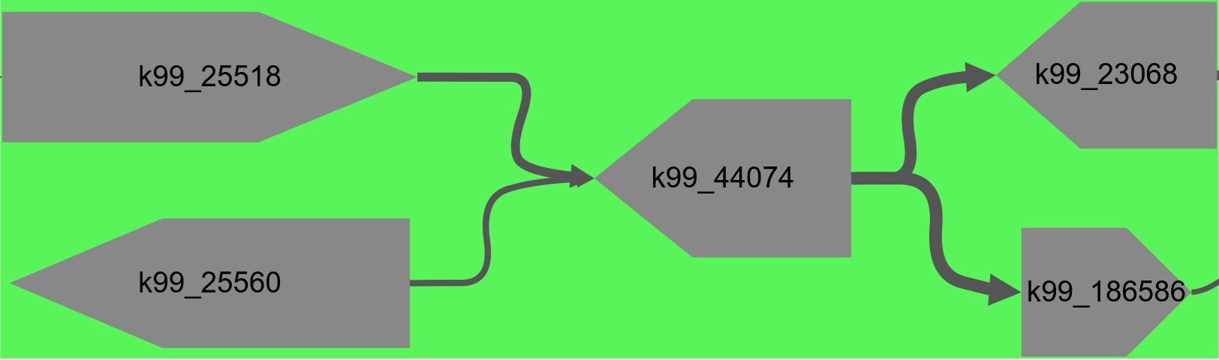
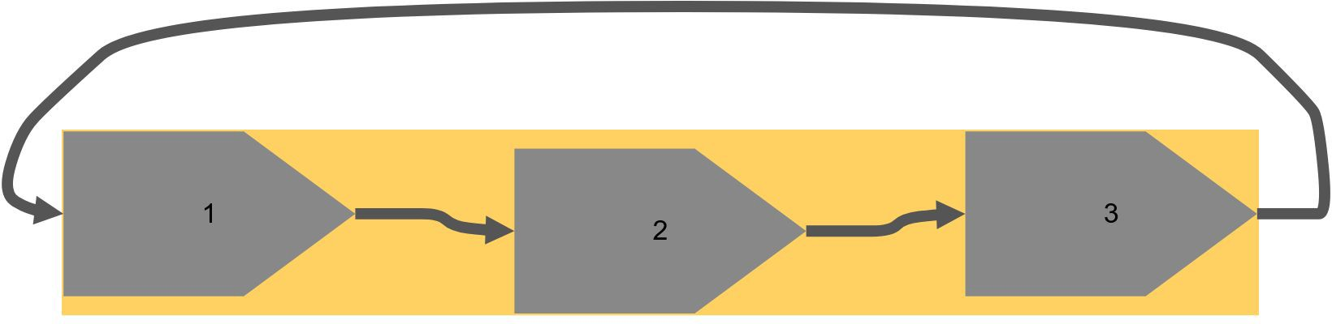
Identifying Structural Patterns in Assembly Graphs
(See Miller, Koren, Sutton 2010)
Bubble
Frayed Rope
Chain
Cyclic Chain

Slide 35
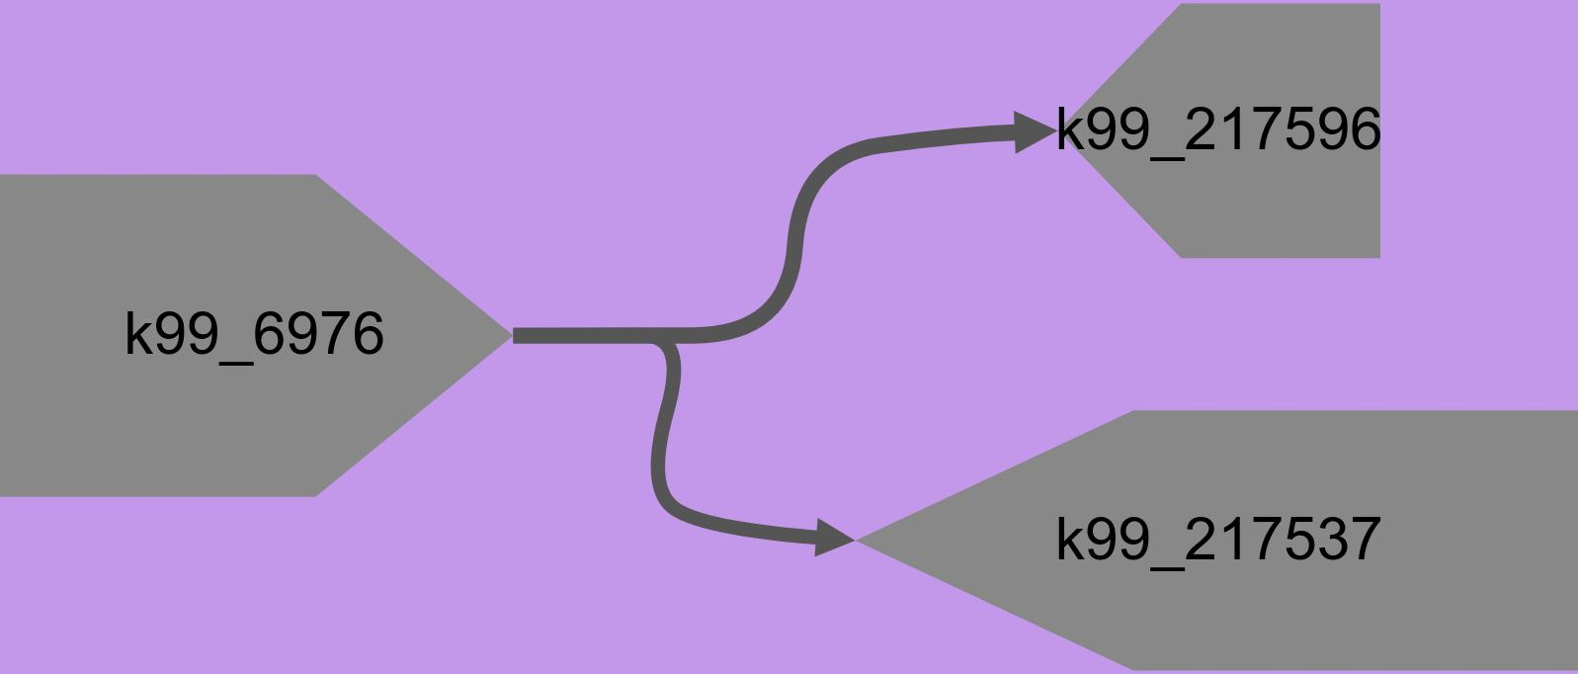
Identifying Structural Patterns in Assembly Graphs
(See Miller, Koren, Sutton 2010)
Bubble
Frayed Rope
Chain
Cyclic Chain
User-Defined Structures

Slide 36
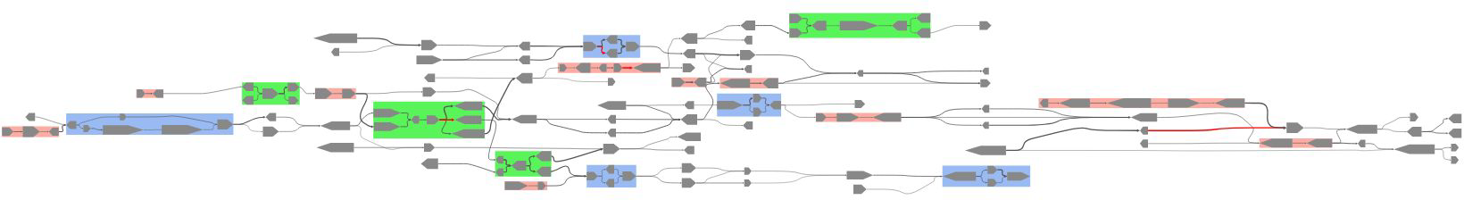
Identifying Structural Patterns in Assembly Graphs
(See Miller, Koren, Sutton 2010)
Patterns can be collapsed/uncollapsed to decrease/increase graph complexity.
Bubble
Frayed Rope
Chain
region of an assembly graph created from Human Microbiome Project (HMP) data, accession ID SRS049959

Slide 37
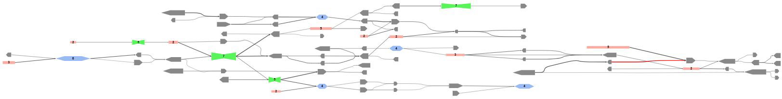
Identifying Structural Patterns in Assembly Graphs
(See Miller, Koren, Sutton 2010)
Patterns can be collapsed/uncollapsed to decrease/increase graph complexity.
Bubble
Frayed Rope
Chain
region of an assembly graph created from Human Microbiome Project (HMP) data, accession ID SRS049959

Slide 38


Exercise #2: Finding a frayed rope
https://gitlab.com/treangen/stamps2019
(this sort of thing)

Slide 39
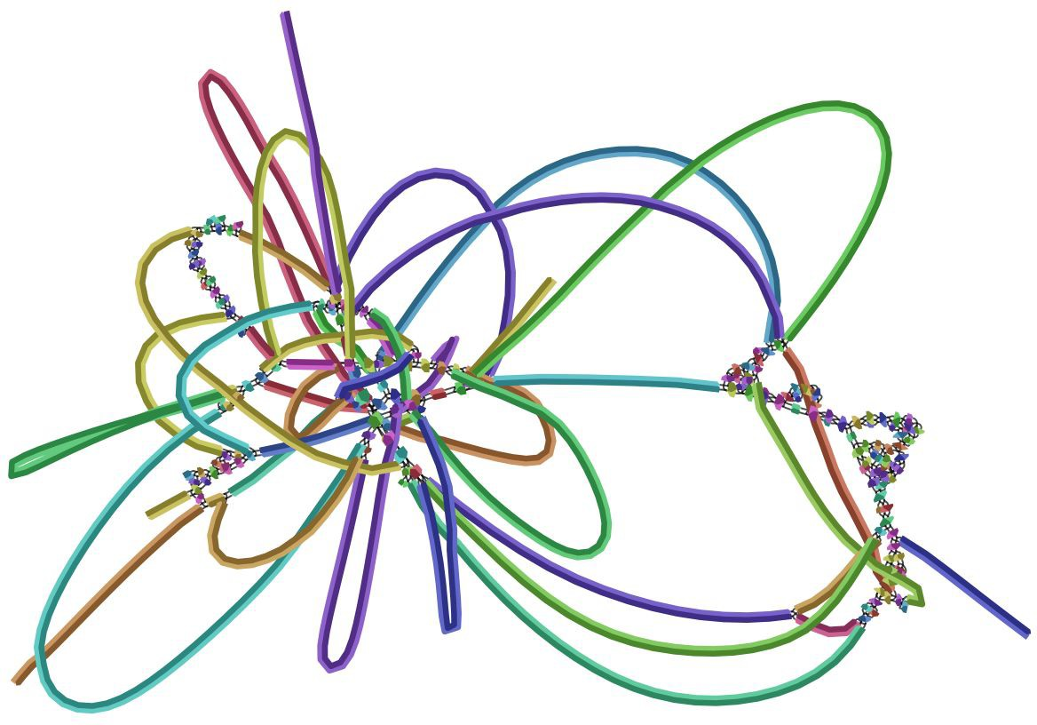
Hierarchical Graph Layout
Bandage, ABySS-Explorer, and Ray Cloud Browser all use force-directed layout algorithms
MetagenomeScope uses Graphviz’ dot program to hierarchically lay out graphs
Largest connected component of an E. coli assembly graph produced with Velvet, visualized in
Bandage (right) and MetagenomeScope (bottom)

Slide 40
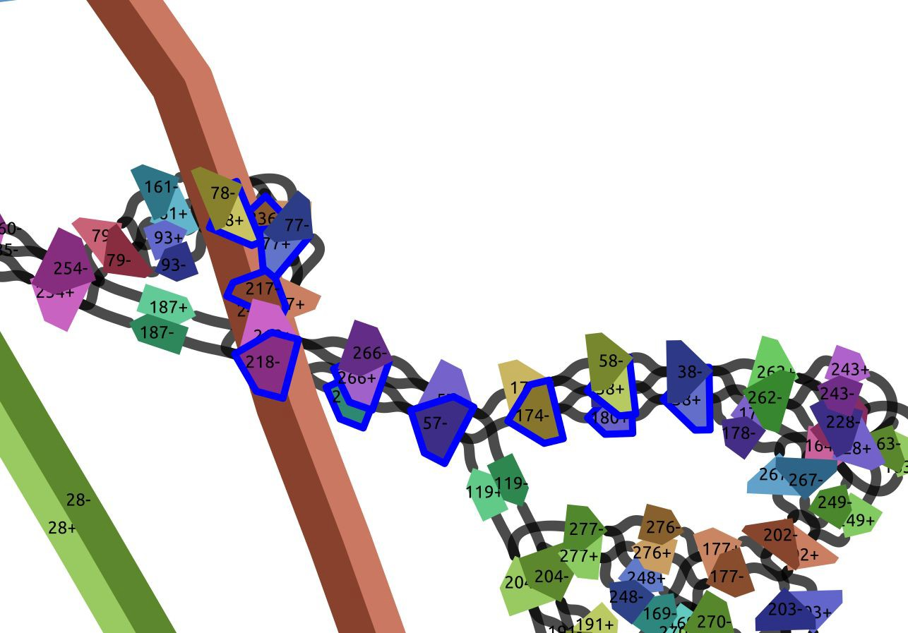
Reviewing that E. coli assembly graph (Bandage)

Slide 41
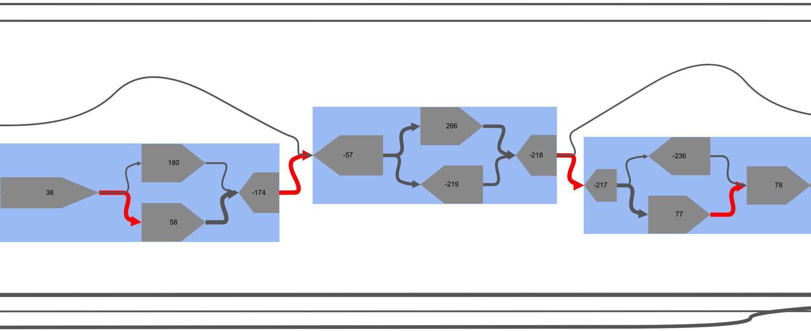
Reviewing that E. coli assembly graph (MetagenomeScope)

Slide 42
Lunch break

Slide 43
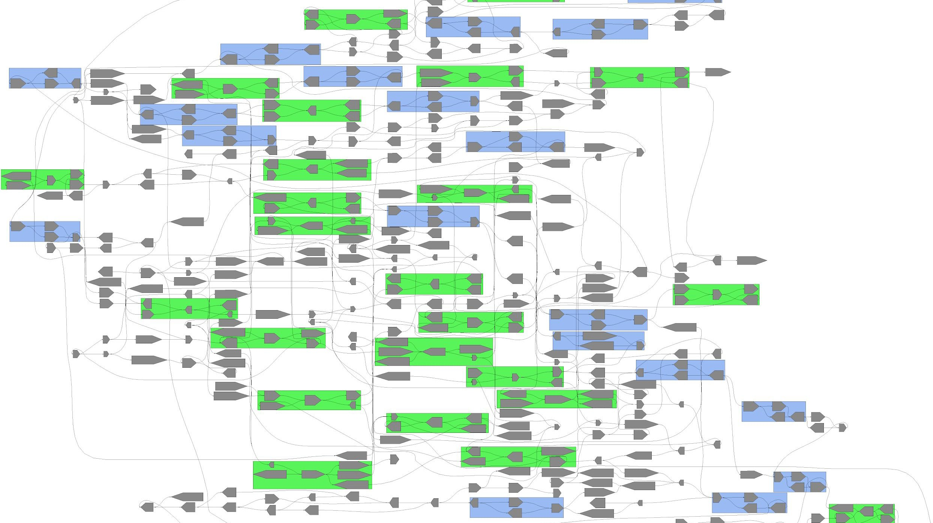
Structural Patterns and Layout Linearization
We modify our input to dot in order to linearize some graphs.

Slide 44
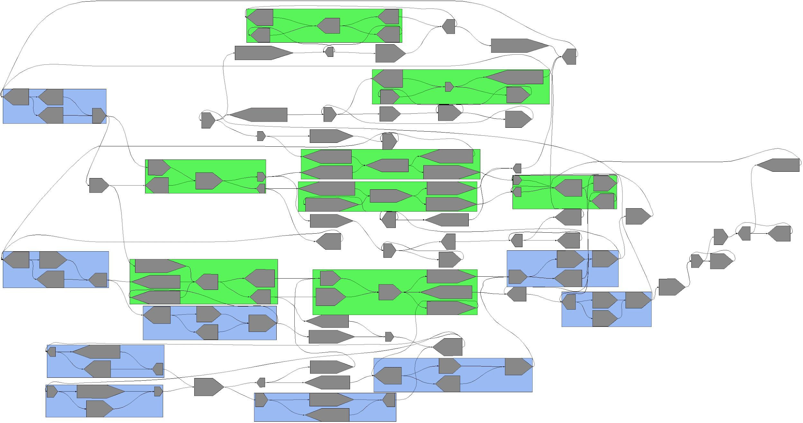
Structural Patterns and Layout Linearization
Initial Approach
Node groups (structural patterns) represented as “clusters” when laying out the graph.
Entire connected component is laid out at once.
Sample assembly graph provided
with Bandage (Salmonella enterica)

Slide 45
Structural Patterns and Layout Linearization
Initial Approach
Node groups (structural patterns) represented as “clusters” when laying out the graph.
Entire connected component is laid out at once.
Note that dot routes edges through clusters.
Sample assembly graph provided
with Bandage (Salmonella enterica)

Slide 46
Structural Patterns and Layout Linearization
Initial Approach
Node groups (structural patterns) represented as “clusters” when laying out the graph.
Entire connected component is laid out at once.
Note that dot routes edges through clusters.
Can we avoid this?
Sample assembly graph provided
with Bandage (Salmonella enterica)

Slide 47
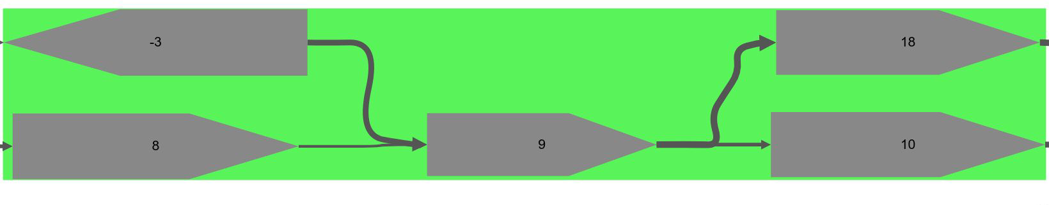
Structural Patterns and Layout Linearization
Revised Approach
Node groups (structural patterns) laid out in isolation.
Their bounding box dimensions (and the relative positions of their child nodes and edges) are stored.

Slide 48
Structural Patterns and Layout Linearization
Revised Approach
Node groups (structural patterns) laid out in isolation.
Their bounding box dimensions (and the relative positions of their child nodes and edges) are stored.

Slide 49
Structural Patterns and Layout Linearization
Revised Approach
Node groups (structural patterns) laid out in isolation.
Their bounding box dimensions (and the relative positions of their child nodes and edges) are stored.

Slide 50
Structural Patterns and Layout Linearization
Revised Approach
Node groups (structural patterns) laid out in isolation.
Their bounding box dimensions (and the relative positions of their child nodes and edges) are stored.

Slide 51
Structural Patterns and Layout Linearization
Revised Approach
Node groups (structural patterns) laid out in isolation.
Their bounding box dimensions (and the relative positions of their child nodes and edges) are stored.

Slide 52
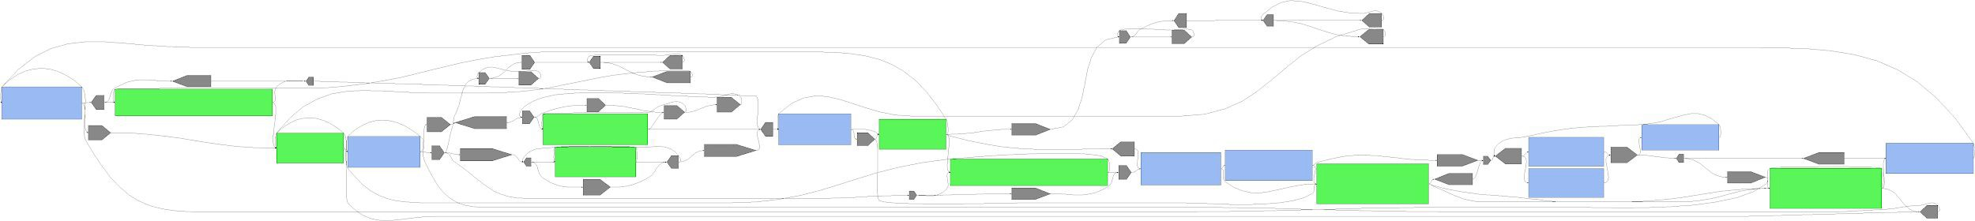
Structural Patterns and Layout Linearization
Revised Approach
Node groups (structural patterns) laid out in isolation.
Their bounding box dimensions (and the relative positions of their child nodes and edges) are stored.
Each node group is represented by a rectangular node of those dimensions during the component layout.
Sample assembly graph provided
with Bandage (Salmonella enterica)

Slide 53
Structural Patterns and Layout Linearization
Revised Approach
Node groups (structural patterns) laid out in isolation.
Their bounding box dimensions (and the relative positions of their child nodes and edges) are stored.
Each node group is represented by a rectangular node of those dimensions during the component layout. After the component layout process, “child” nodes and edges are backfilled into their parent node groups.
Sample assembly graph provided
with Bandage (Salmonella enterica)

Slide 54
Structural Patterns and Layout Linearization
Revised Approach
Node groups (structural patterns) laid out in isolation.
Their bounding box dimensions (and the relative positions of their child nodes and edges) are stored.
Each node group is represented by a rectangular node of those dimensions during the component layout. After the component layout process, “child” nodes and edges are backfilled into their parent node groups. This prevents edges from being routed through node groups, linearizing the resulting layout.
Sample assembly graph provided
with Bandage (Salmonella enterica)

Slide 55
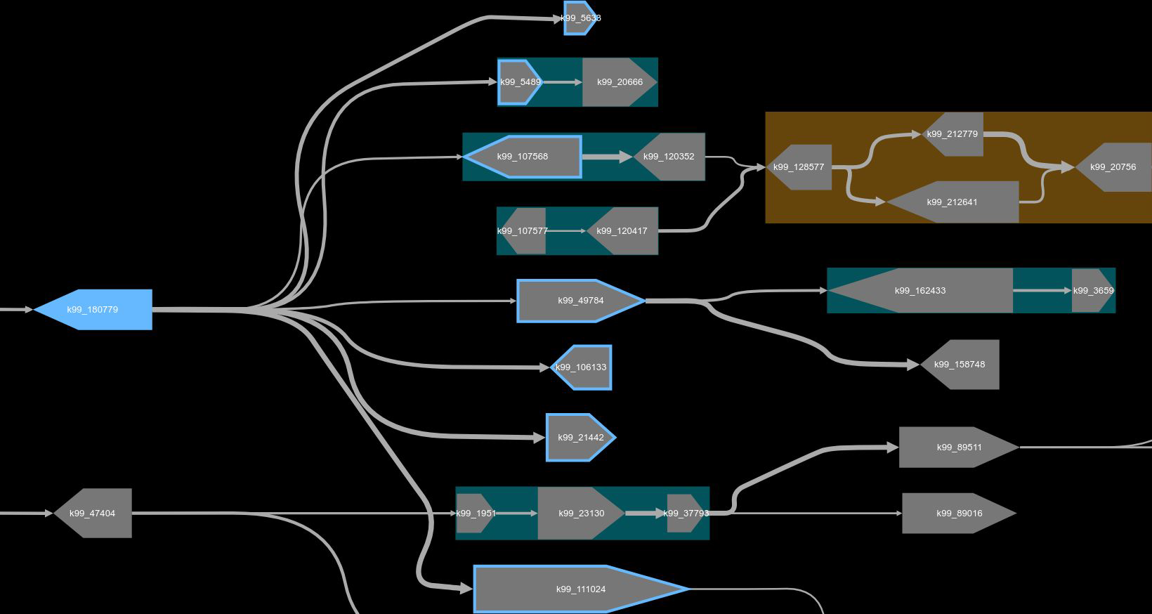
Path Construction and Visualization
MetagenomeScope includes tools that facilitate these tasks:
1. Select path(s) through an assembly graph

Slide 56
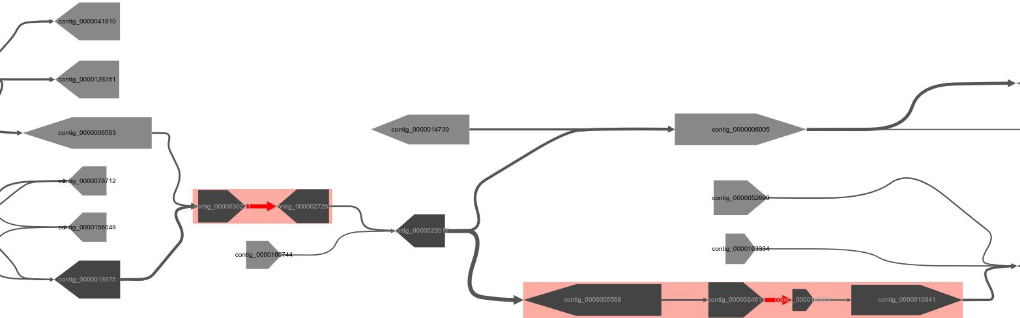
Path Construction and Visualization
MetagenomeScope includes tools that facilitate these tasks:
Select path(s) through an assembly graph
Visualize existing paths on top of an assembly graph

Slide 57
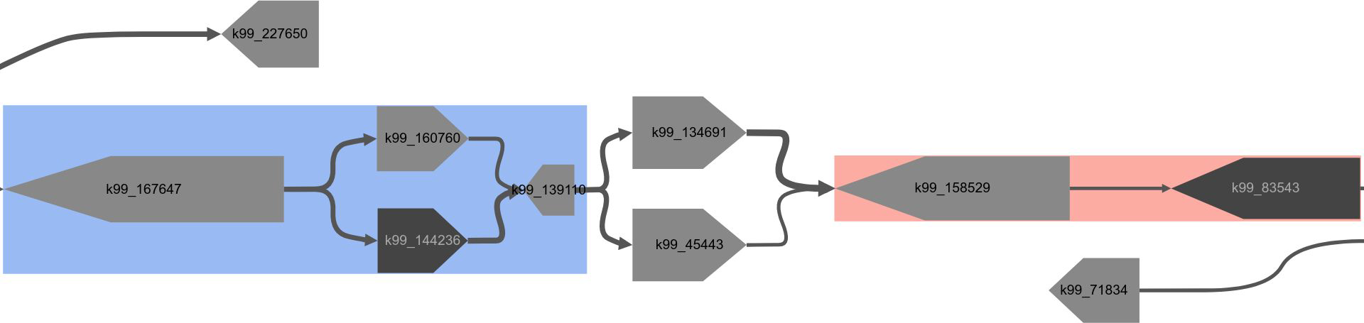
Path Construction and Visualization
MetagenomeScope includes tools that facilitate these tasks:
Select path(s) through an assembly graph
Visualize existing paths on top of an assembly graph
Identify errors in path generation

Slide 58

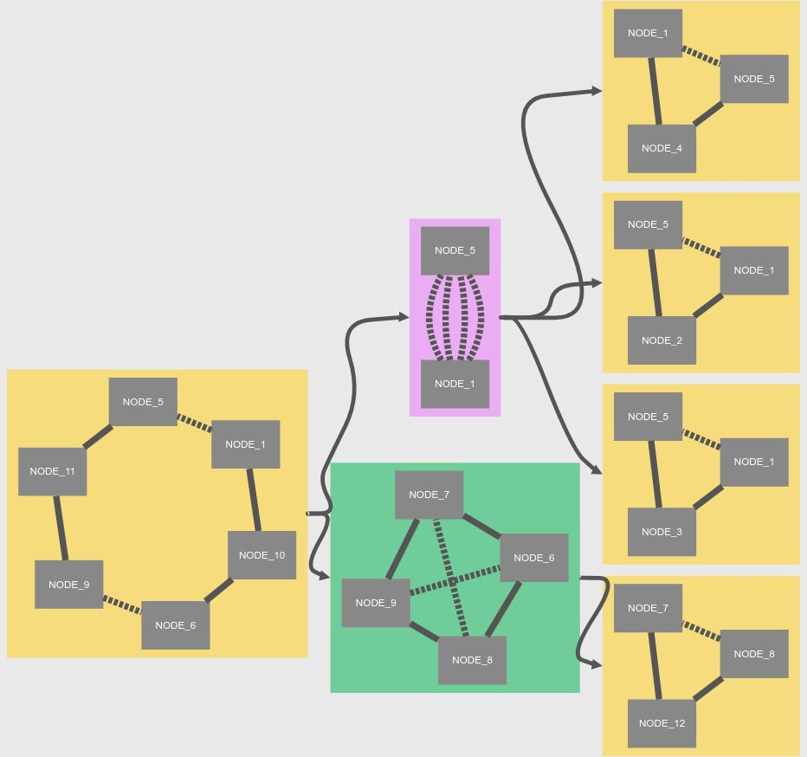
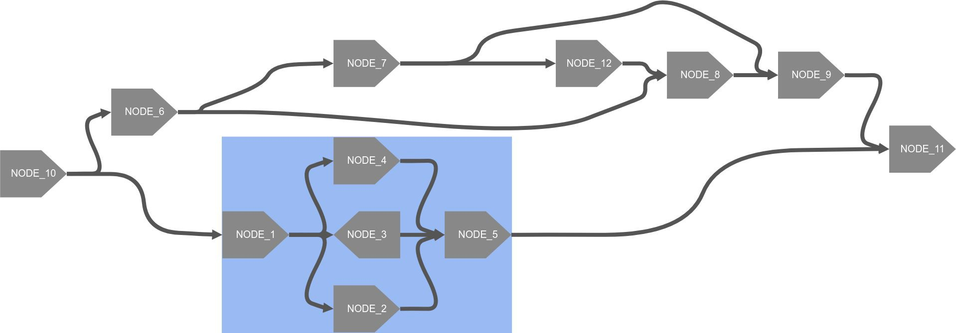
SPQR Tree Decomposition
Decomposition of biconnected graph into triconnected components
Data structure originally used for testing graph planarity
Link between triconnected components and bubbles
Generatable using the -spqr option

Slide 59
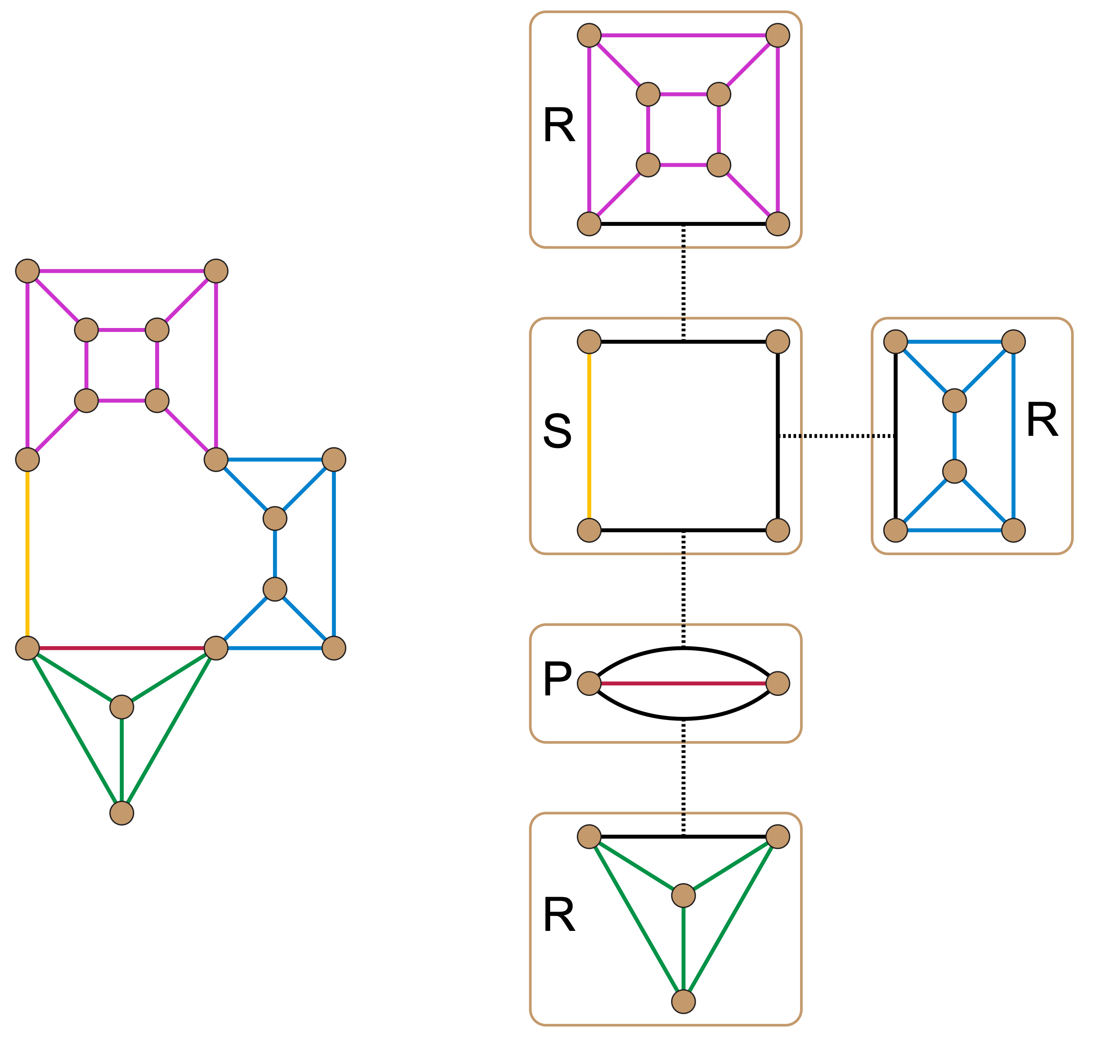
An SPQR tree takes the form of an unrooted tree in which for each node x there is associated an undirected graph or multigraph G_{x}.
The node, and the graph associated with it, may have one of four types, given the initials SPQR
https://en.wikipedia.org/wiki/SPQR_tree

Slide 60
Exercise #3: Viewing an SPQR tree two ways
Open the “MaryGold Paper Figure 2 graph” demo graph in MetagenomeScope’s viewer interface
Draw the “explicit” and “implicit” SPQR tree graphs, and fully expand the graph display by right-clicking metanodes
What similarities do you see? What differences?

Slide 61
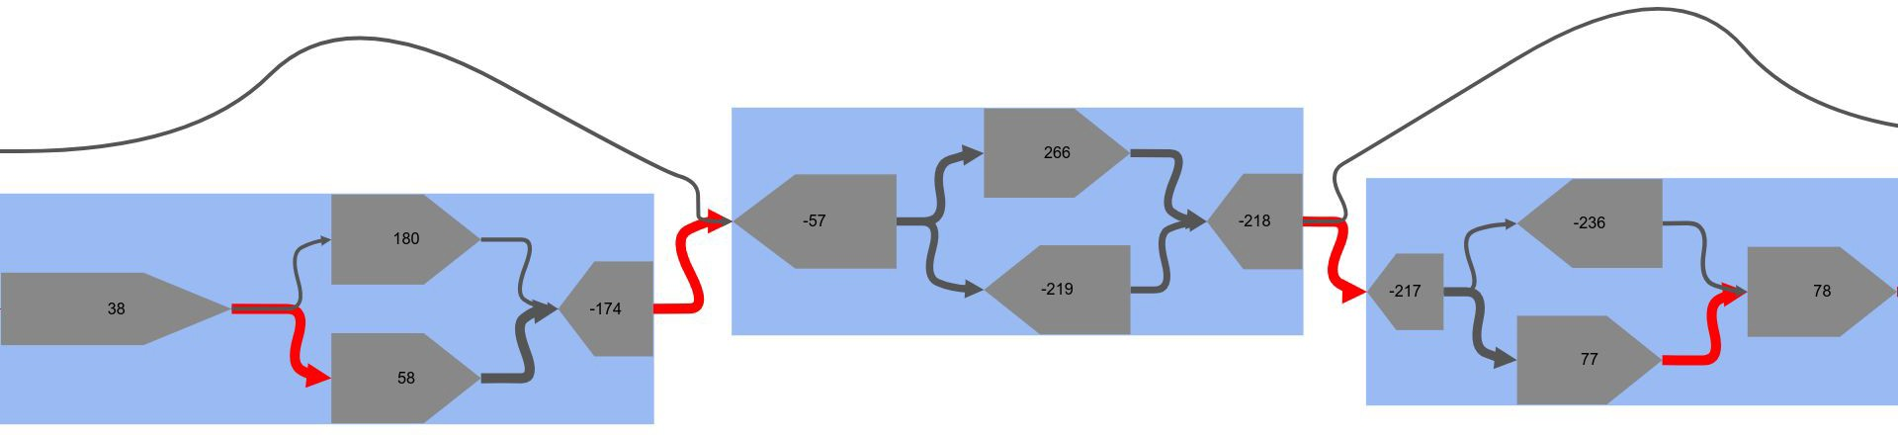
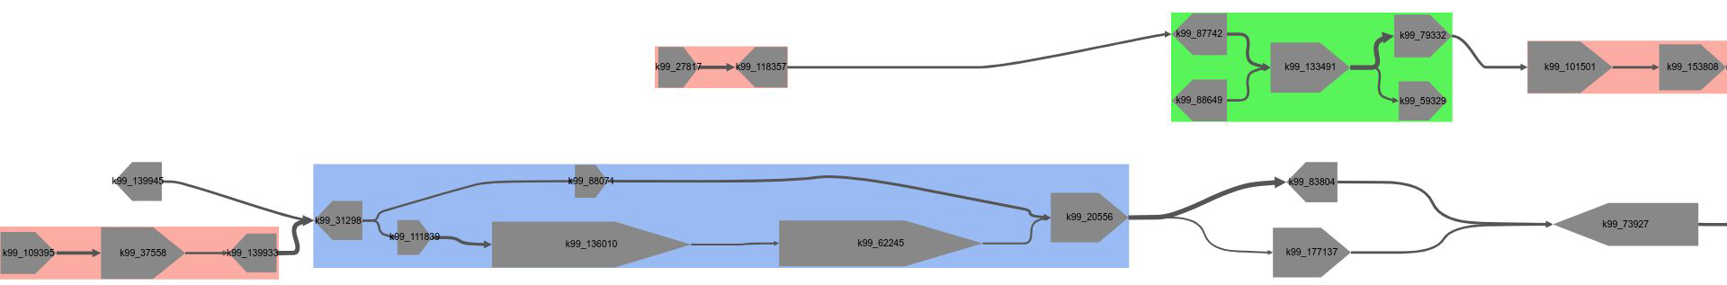
How MetagenomeScope Scales Nodes and Edges
Scaling nodes’ area
Logarithmic → relative scaling of node area, based on length
Width/height proportions are altered based on percentiles: makes larger nodes look “longer”
Scaling edges’ thickness
Using Tukey fences to identify outlier edge weights
Flagging outliers in the display

Slide 62
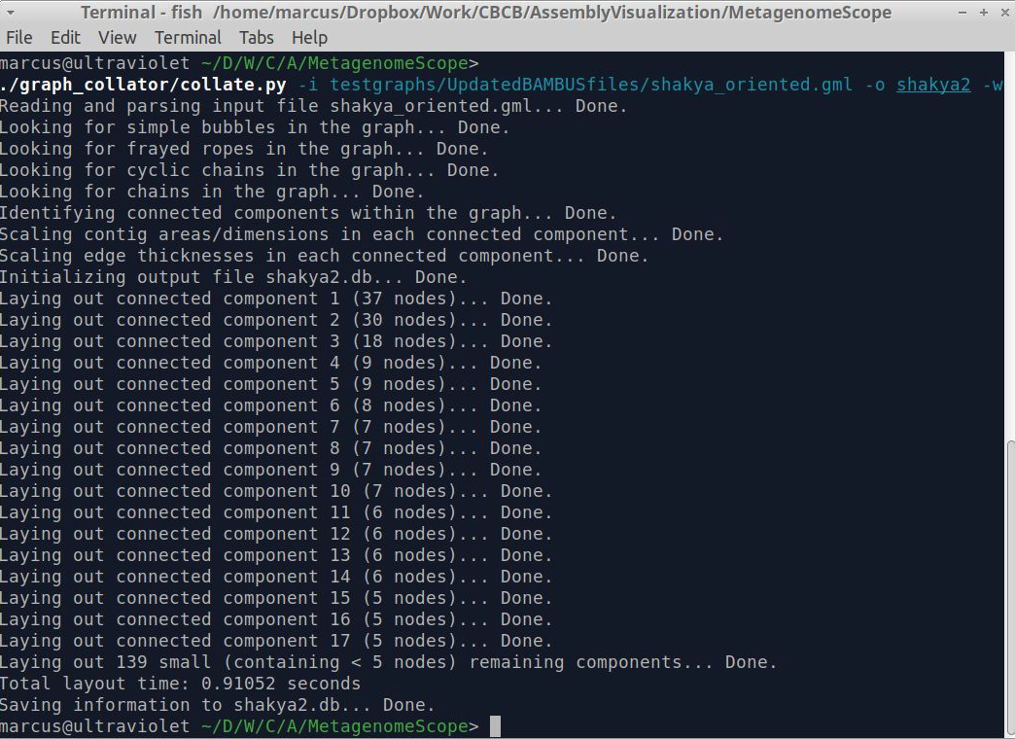
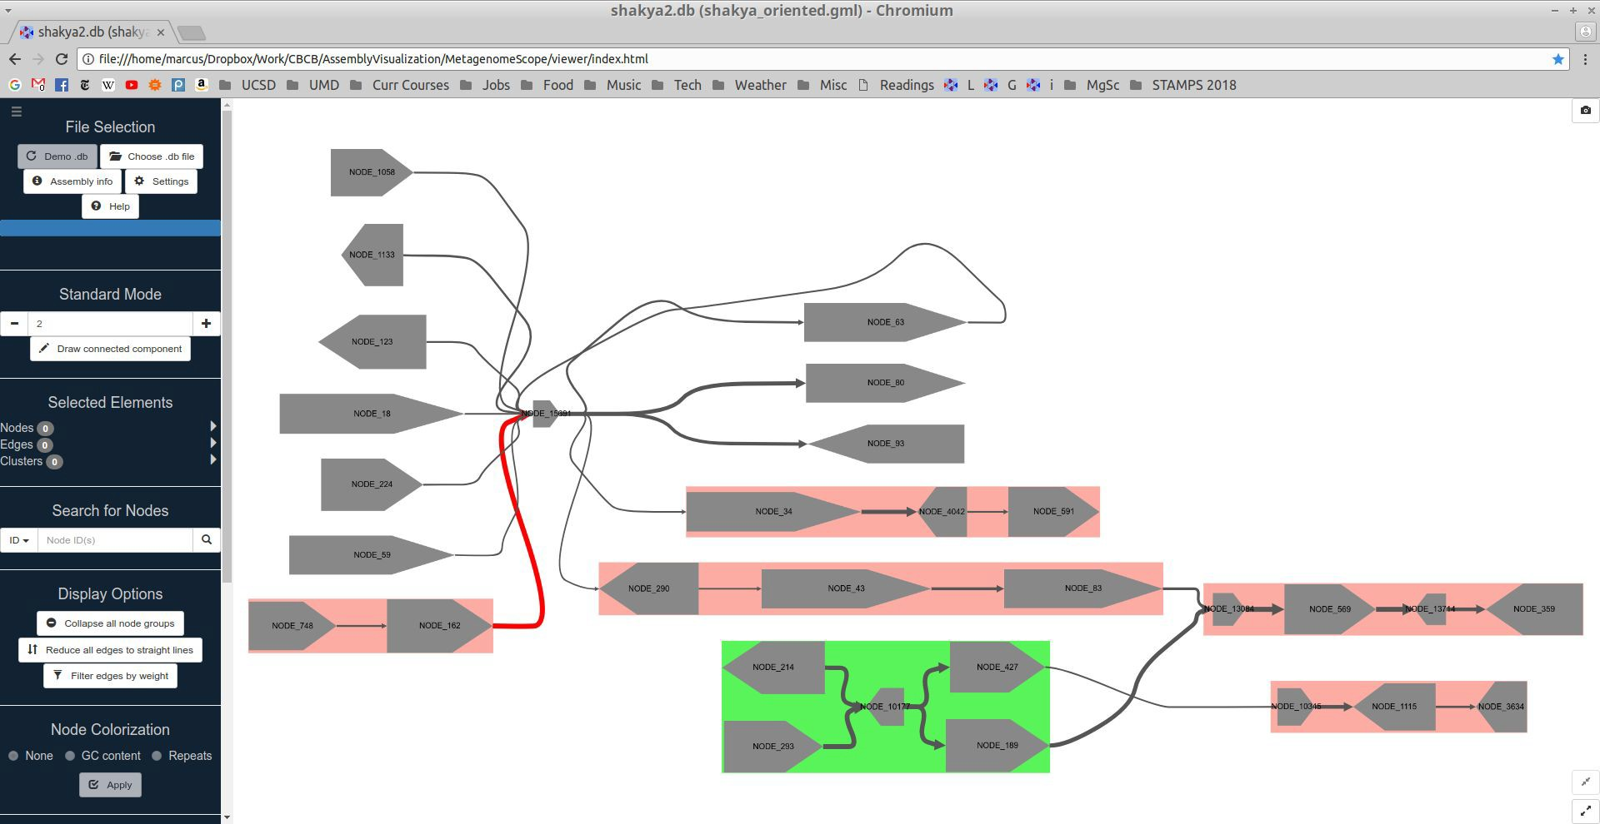
Implementation
Command-line preprocessing script and web viewer interface
Script produces a SQLite3 database file, which is parsed on the client side using sql.js
Graph visualization is done on the client side (“serverlessly”) using Cytoscape.js
Various tradeoffs in this approach (database filesize, layout time, …)
Source code on GitHub under the GNU GPL, version 3

Slide 63
File Formats Accepted
Velvet (.LastGraph)
General (.gfa)
MetaCarvel (.gml)
SPAdes/MEGAHIT (.fastg) (sort of)

Slide 64
Exercise #4: Find an interesting pattern in the HMP (SRS049959) demo graph
Human stool sample
Sample processed by ATLAS in previous tutorial

Slide 65
Summary
MetagenomeScope: new tool for visualizing/interacting with assembly graphs
Uses a hierarchical layout algorithm
Identifies structural patterns in the graph
Can be collapsed/uncollapsed
Influences the hierarchical layout process
Supports various novel features that augment exploratory analysis of assembly graphs

Slide 66
Reference-guided metagenomic assembly and strain-level analyses

Slide 67
What is reference-guided assembly?
An assembler with a strong assumption that genomes in your metagenome look a lot like those that are in a reference database.
If this is a reasonable assumption, proceed with caution:
Hint: rearrangements, horizonal gene transfer, and duplications are common!
If this is not a reasonable assumption (viral genomes, soil samples), think de novo assembly:
Megahit
MetaSpades

Slide 68
Microbial genomes evolve over time
The presence of two or more homologous sequences within a single genome might reflect the acquisition of DNA sequence from a foreign source rather than the duplication of a resident gene.
Thus, since we do not know the origin a priori, we refer to these potential paralogs or xenologs as synologs (Lerat et al 2005).

Slide 69
Ubiquitous sequence fragments
= ubiquitous with synologs (constant)
= core genome
= ubiquitous with synologs (variable)

Slide 70
Non-Ubiquitous sequence fragments
= core genome
= non-ubiquitous with synologs (constant)
= genome specific
= non-ubiquitous with synologs (variable)
= singletons
= non-ubiquitous without synologs

Slide 71
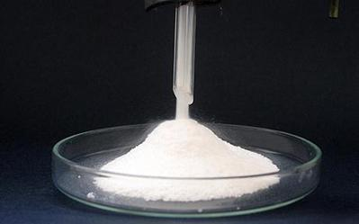
Powdered water -- to drink, just add water.

Slide 72
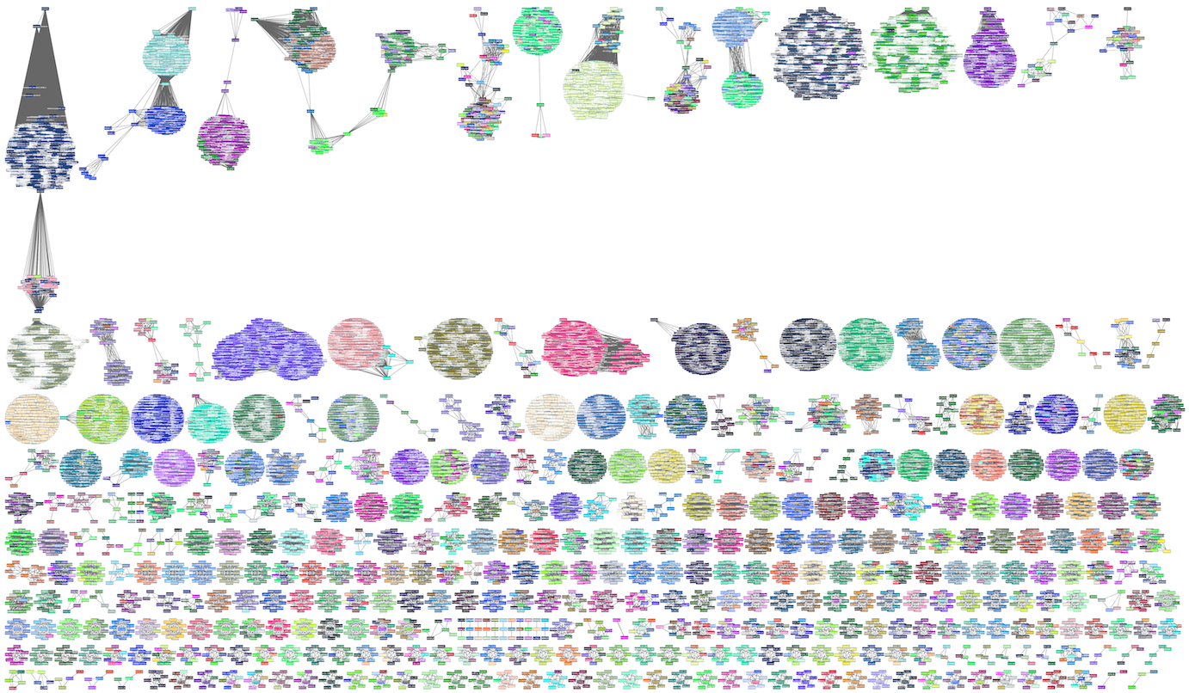
Mycobacterium
tuberculosis
Klebsiella pneumoniae
B. cereus group
Escherichia coli & Shigella
Acinetobacter baumannii
Streptococcus agalactiae

Slide 73
Reference-guided metagenomic assembly
Ready, set, go!

Slide 74
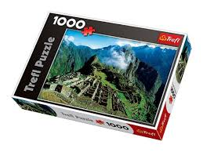
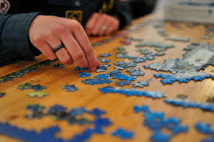
Reference-guided genome assembly
Reconstructing the original DNA sequence aligning reads to a genome.
Intuitively like a puzzle
But we have the box!
Notes:
All the work im gonna present today is based on metagenomics
what is metagenomics and why ?
in general terms, metagenomics is the study of microorganisms
1Why Metagenomics? Microbes run the world. It’s that simple. Although we can’t usually see them, microbes are essential for every part of human life—indeed all life on Earth. Every process in the biosphere is touched by the seemingly endless capacity of microbes to transform the world around them. The chemical cycles that convert the key elements of life—carbon, nitrogen

Slide 75
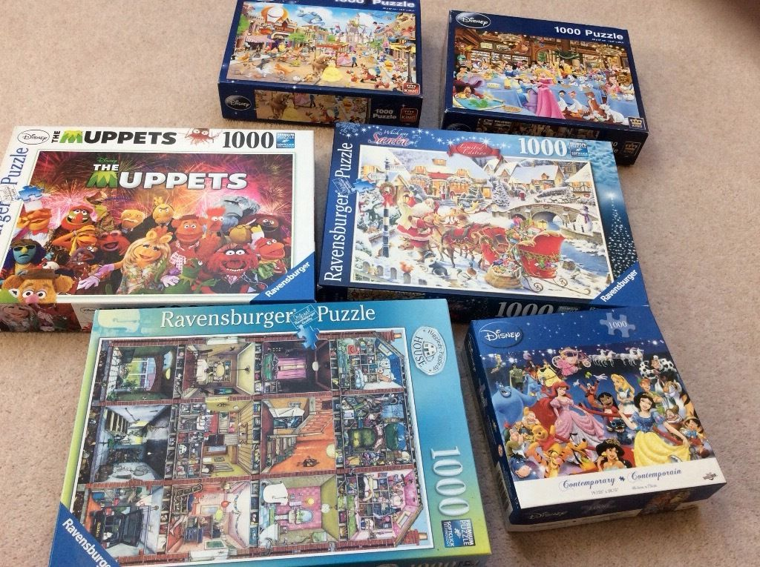
Reference-guided metagenome assembly
Reconstructing original DNA sequences aligning reads to a set of genomes.
Intuitively like multiple puzzles
But we need to find the boxes!
Notes:
All the work im gonna present today is based on metagenomics
what is metagenomics and why ?
in general terms, metagenomics is the study of microorganisms
1Why Metagenomics? Microbes run the world. It’s that simple. Although we can’t usually see them, microbes are essential for every part of human life—indeed all life on Earth. Every process in the biosphere is touched by the seemingly endless capacity of microbes to transform the world around them. The chemical cycles that convert the key elements of life—carbon, nitrogen

Slide 76
Reference-guided metagenome assembly
Step 1: Find the puzzle boxes (reference selection)
Step 2: Bin pieces into the right boxes (read mapping)
Step 3: Solve each puzzle (assembly)
Notes:
board and brew
describe how to find boxes, db is much larger
All the work im gonna present today is based on metagenomics
what is metagenomics and why ?
in general terms, metagenomics is the study of microorganisms
1Why Metagenomics? Microbes run the world. It’s that simple. Although we can’t usually see them, microbes are essential for every part of human life—indeed all life on Earth. Every process in the biosphere is touched by the seemingly endless capacity of microbes to transform the world around them. The chemical cycles that convert the key elements of life—carbon, nitrogen

Slide 77
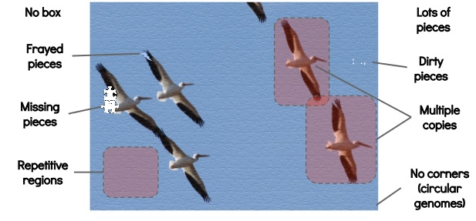
What makes a puzzle hard?
Slide credit → Torsten Seemann
Notes:
dirty and frayed pieces erros
redo?
cite this
https://www.slideshare.net/torstenseemann/de-novo-genome-assembly-tseemann-imb-winter-school-2016-brisbane-au-4-july-2016

Slide 78
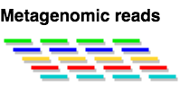
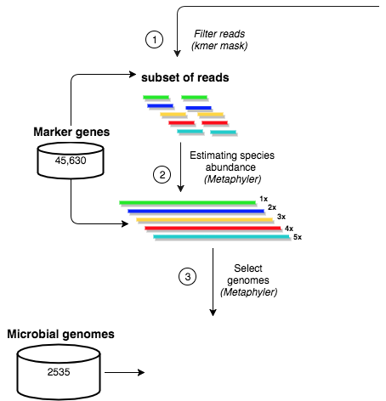
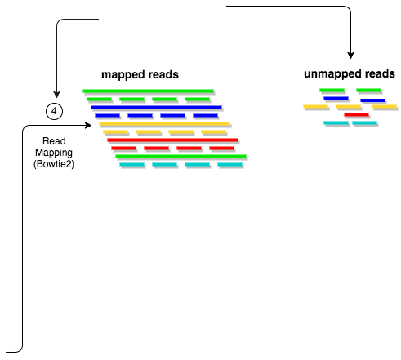
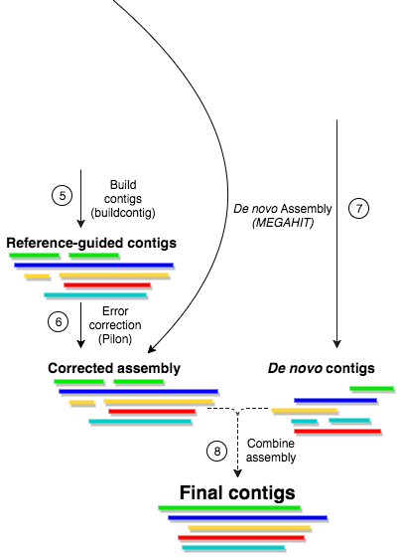
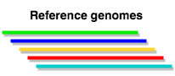
MetaCompass overview
Notes:
Reference selection: filter reads, estimate depth of coverage
Read mapping
reference-guided assembly
error correction
de novo assembly

Slide 79
Reference Selection
Notes:
Kmer approach to filter the reads before metaphyler
Reference selection: filter reads, estimate depth of coverage
Read mapping
reference-guided assembly
error correction
de novo assembly

Slide 80
Read mapping
Notes:
Bowtie2 to do the read mapping an kept the unmapped reads
Explain problem i want to solve in each step, go back to puzzle analogy, challenges
Reference selection: filter reads, estimate depth of coverage
Read mapping
reference-guided assembly
error correction
de novo assembly

Slide 81
Metagenomic
assembly
Notes:
After the reference guiede assembly we included and error correction approach to avoid biased assembly and only de novo assembly unmmpaed reads
Reference selection: filter reads, estimate depth of coverage
Read mapping
reference-guided assembly
error correction
de novo assembly

Slide 82

Choose your own adventure: how shall we identify the reference genomes?
Universal marker gene- based approaches (MetaPhlan, MetaPhyler, etc)
MinHash based approaches (Mash, SourMash, etc)
Kmer + LCA based approaches (Clark, Kraken, etc)
http://tiny.cc/stamps19

Slide 83

STEP 1: Reference selection
Notes:
Beyond the scope
Remove some text/4 lines/ describe it differently
2 points: real reference is not available. use puzzle boxes
For single genomes, reference-guided assembly is useful whenever trusted references exist. Many available methods exist for mapping (and then scaffolding) the generated draft contigs.
For metagenomes, reference-guided assembly has not been used because the composition of the samples is unknown.
While database driven approaches have been employed in certain metagenome analyses, they have not been used in the assembly of metagenomic data. This is in part due to the small size and biased coverage of public genome databases, but also due to the inherent computational cost of mapping tens of millions of reads to thousands of full genome sequences.

Slide 84

STEP 1: Reference selection
Notes:
Beyond the scope
Remove some text/4 lines/ describe it differently
2 points: real reference is not available. use puzzle boxes
For single genomes, reference-guided assembly is useful whenever trusted references exist. Many available methods exist for mapping (and then scaffolding) the generated draft contigs.
For metagenomes, reference-guided assembly has not been used because the composition of the samples is unknown.
While database driven approaches have been employed in certain metagenome analyses, they have not been used in the assembly of metagenomic data. This is in part due to the small size and biased coverage of public genome databases, but also due to the inherent computational cost of mapping tens of millions of reads to thousands of full genome sequences.

Slide 85

STEP 1: Reference selection

Slide 86
Survey results:
https://ql.tc/axwUgB

Slide 87
Read mapping
Notes:
Bowtie2 to do the read mapping an kept the unmapped reads
Explain problem i want to solve in each step, go back to puzzle analogy, challenges
Reference selection: filter reads, estimate depth of coverage
Read mapping
reference-guided assembly
error correction
de novo assembly

Slide 88

STEP 2: Read mapping

Slide 89

STEP 2: Read mapping
G1
G2
G3
G4

Slide 90

Treangen and Salzberg, Nature Reviews Genetics, 2015

Slide 91
Choose your own adventure: how shall we map reads to the recruited genomes?
All → map all reads to every equally good mapping location
Random → randomly assign reads amongst equally good mapping location
Depth → genome with highest depth of coverage takes all of the reads that map to it
Breadth → genome with highest breadth of coverage takes all the reads that map to it
http://tiny.cc/stamps19

Slide 92
READ MAPPING: How to place reads?
Notes:
Building contigs from read mapping records. Shorter bars represent shotgun reads; longer bars represent reference genomes (4 genomes in this figure). Regions with the same color in the reference genomes represent homologous sequences. (a) All read mapping records. A read may be mapped to several reference genomes equally well, e.g., 5 yellow reads are mapped to both of the first two genomes.
Remove redundant mepping
A problem in metagenomes is that many genomes are very similar
the image shows four genomes. same color indicates shared region across genomes. blue reads map to all gebomes, yellow maps to 2 genomes, green only to one genome and red and purple genomes dont get any read aligned
by definition, each reads should be mapped uniquely to one genome, howwver we get something like this
put pipeline at the end and show how to improve it

Slide 93
Random assignment “coin flip”
Notes:
(b) For each read, if it is mapped to more than one reference genome, we randomly pick one.
Best match for the reads. But there are multiple best matches across different genomes.
most assembler heuristics will give something like this

Slide 94
Rank by depth of coverage
Notes:
(c) A read is assigned to a reference with highest depth of coverage.
Assign reads to Genome where the depth of coverage is highest
Depth of coverage: Assign the reads to the genome with highest depth of coverage
make pairs: ab,ac,ad
b) not “best”
bowtie, bwa can give b
put pipeline at the end and show how to improve it

Slide 95
Rank by minimum set cover
Notes:
(d) We pick the minimum number of reference genomes, to which all reads can be mapped.
minimum number of genomes that contain most of the reads.
this allow to generate a more contiguous and complete assembly than the other types of mappings

Slide 96
Survey results:
https://ql.tc/axwUgB

Slide 97
Minimum set cover?
Given a set of elements U { 1 , 2 , . . . , n } and a collection S of m sets whose union equals the universe, the set cover problem is to identify the smallest sub-collection of S whose union equals the universe.
For example, consider the universe U = { 1 , 2 , 3 , 4 , 5 } and the collection of sets S = { { 1 , 2 , 3 } , { 2 , 4 } , { 3 , 4 } , { 4 , 5 } } the union of S is U.
The minimum set cover is the smallest number of m sets that cover U:
{ { 1 , 2 , 3 } , { 4 , 5 } }
For reference selection, it’s the smallest number of genomes that cover all of the input reads.

Slide 98
Read mapping selection: Minimum set cover
Notes:
Of theses 4 strategies we pick the minimum set cover
make pairs: ab,ac,ad
b) not “best”
bowtie, bwa can give b
put pipeline at the end and show how to improve it

Slide 99
STEP 3: Building the contigs
C
Reads
TGCACGGATG TGCATGCACG
TTAATGCACG TG–ATGCATG
TGGATTAATG TGGATG–ATG
TGGATTCATGCATGGATGCATGCATGCACG Reference
TGGATTAATGCACGGATG–ATGCACTGCACG Contig
C
Min. depth of coverage:2
Min. length:10

Slide 100
STEP 4: de novo assembly
Assembly unmapped reads to reference
De novo assembly using MEGAHIT

Slide 101
Evaluation Datasets
Dataset 1: Synthetic dataset, Shakya et. al.
Dataset 2: Down-sampled Dataset 1(low coverage)
Dataset 3: 2,077 samples from HMP2

Slide 102
Results - Dataset 1
Mixture of 64 bacterial and archaeal species (Shakya et al., 2013)
109 million reads with mean insert size 206 bp and 100 bp read length
Easier to evaluate assembly since the truth is known

Slide 103
Results – Assembly Statistics
Method | No. Contigs | Longest Contig (bp) | Median genome recovery | Mismatches (Per 1Mbp) | Misassemblies (Per 1Mbp)
MetaCompass | 18,766 | 7,057,109 | 100% | 61.9 | 1.9
IDBA-UD | 22,355 | 991,792 | 98% | 98.6 | 6.3
MEGAHIT | 35,351 | 1,151,857 | 99% | 66.5 | 2.5
metaSPAdes | 21,424 | 1,438,235 | 99% | 97.1 | 2.3
Notes:
14mbp longest bacteria
Repeats: 7kbp
Complete bacteria
Less contigs, less fragmented assembly
Genome size contigs, we can reconstruct an entire bacterial from short reads
Median genome recovery mapping contigs to the reference genomes
Doing less erros
Mismatches are the number of bases in a contig that differ from the reference genome.
Misassemblies include
large-scale (left flanking region aligns >1 kbp away from right flanking region)
relocations, interspecies relocations, translocations, and inversions.
The number of misassemblies and local misassemblies per 1 Mbp of assembled sequence (as reported by MetaQUAST [77]) increased from 2.0 to 4.9 when reducing the coverage threshold to 1. To put this increase into context, we measured the total number of possible errors by evaluating the "accuracy" of the near-neighbor reference genomes recruited by MetaCompass with respect to the correct reference sequence
Errors. How big bacterias are?
Table 1. MetaCompass (X) indicate the minimum coverage setting, and MetaCompass.nr indicates all 64 reference genomes comprising the Shakya et al. dataset were removed from the database.
MEtacompass outperformed de novo assemblers
Find what is the expected number of ORFS per mb in bacterial genomes
Better metric is ORFS in scaff - ORFs in contigs

Slide 104


Slide 105


Slide 106


Slide 107
MetaCompass tutorial
-- I have a set of metagenomic reads and want to perform reference-guided assembly.
python go_metacompass.py -P [read1.fq,read2.fq] -l [max read length]-o [output_folder] -t [ncpu]
-- I know the reference genomes and have a set of metagenomic reads
python go_metacompass.py -r [references.fasta] -P [read1.fq,read2.fq] -o [output_folder] -t [ncpu]
Output directory:
Assembled contigs: metacompass_output/metacompass.final.ctf.fa Selected Reference genomes: metacompass_output/metacompass.recruited.fa

Slide 108
Docker details
Where do I save my output?
/output
How do I exit the container?
exit
How do I access my output after exiting the container?
cd /home/stamps19/chiron/metacompass

Slide 109

Warming up: Carsonella ruddii
Obligate endosymbiotic Gamma protobacteria
Present in all species of phloem sap-feeding insects known as psyllids

Slide 110
Your turn!
https://gitlab.com/treangen/stamps2019/README.md#part2

Slide 111
Strain-level analyses
AGCAGCCCGTAGGCTACCCGGGAATGGGGGTATACCAATATACGATCGACTGACTAGGCTATTTTTAAACGATCGATCGATTAAGGCTATTG----------GCAGCCAGTGGGAAGGGAGG
AGCAGCCCGTAGGCTACCCGGGAATGGGGGTATACCAATATACGATCGACTGACTAGGCTATTTTTAAACGATCGATCGATTAAGGCTATTG----------GCAGCCAGTGGGAAGGGAGG
AGCAGCCCGTAGGCTACCCGGGAATGGGGGTATACCAATATACGATCGACTGACTAGGCTATTTTTAAACGATCGATCGATTAAGGCTATTG----------GCAGCCAGTGGGAAGGGAGG
AGCAGCCCGTAGGCTACCCGGGAATGGGGGTATACCAATATACGATCGACTGACTAGGCTATTTTTAAACGATCGATCGATTAAGGCTATTG----------GCAGCCAGTGGGAAGGGAGG
AGCAGCCCGTAGGCTACCCGGGAATGGGGGTATACCAATATACGATCGACTGACTAGGCTATTTTTAAACGATCGATCGATTAAGGCTATTG----------GCAGCCAGTGGGAAGGGAGG
AGCAGCCCGTAGGCTACCCGGGAATGGGGGTATACCAATATACGATCGACTGACTAGGCTATTTTTAAACGATCGATCGATTAAGGCTATTG----------GCAGCCAGTGGGAAGGGAGG
AGCAGCCCGTAGGCTACCCGGGAATGGGGGTATACCAATATACGATCGACTGACTAGGCTATTTTTAAACGATCGATCGATTAAGGCTATTG----------GCAGCCAGTGGGAAGGGAGG
AGCAGCCCGTAGGCTACCCGGGAATGGGGGTATACCAATATACGATCGACTGACTAGGCTATTTTTAAACGATCGATCGATTAAGGCTATTG----------GCAGCCAGTGGGAAGGGAGG
AGCAGCCCGTAGGCTACCCGGGAATGGGGGTATACCAATATACGATCGACTGACTAGGCTATTTTTAAACGATCGATCGATTAAGGCTATTG----------GCAGCCAGTGGGAAGGGAGG
AGCAGCCCGTAGGCTACCCGGGAATGGGGGTATACCAATATACGATCGACTGACTAGGCTATTTTTAAACGATCGATCGATTAAGGCTATTG----------GCAGCCAGTGGGAAGGGAGG
AGCAGCCCGTAGGCTACCCGGGAATGGGGGTATACCAATATACGATCGACTGACTAGGCTATTTTTAAACGATCGATCGATTAAGGCTATTG----------GCAGCCAGTGGGAAGGGAGG
AGCAGCCCGTAGGCTACCCGGGAATGGGGGTATACCAATATACGATCGACTGACTAGGCTATTTTTAAACGATCGATCGATTAAGGCTATTG----------GCAGCCAGTGGGAAGGGAGG
AGCAGCCCGTAGGCTACCCGGGAATGGGGGTATACCAATATACGATCGACTGACTAGGCTATTTTTAAACGATCGATCGATTAAGGCTATTG----------GCAGCCAGTGGGAAGGGAGG
AGCAGCCCGTAGGCTACCCGGGAATGGGGGTATACCAATATACGATCGACTGACTAGGCTATTTTTAAACGATCGATCGATTAAGGCTATTG----------GCAGCCAGTGGGAAGGGAGG
AGCAGCCCGTAGGCTACCCGGGAATGGGGGTATACCAATATACGATCGACTGACTAGGCTATTTTTAAACGATCGATCGATTAAGGCTATTG----------GCAGCCAGTGGGAAGGGAGG
AGCAGCCCGTAGGCTACCCGGGAATGGGGGTATACCAATATACGATCGACTGACTAGGCTATTTTTAAACGATCGATCGATTAAGGCTATTG----------GCAGCCAGTGGGAAGGGAGG
AGCAGCCCGTAGGCTACCCGGGAATGGGGGTATACCAATATACGATCGACTGACTAGGCTATTTTTAAACGATCGATCGATTAAGGCTATTG----------GCAGCCAGTGGGAAGGGAGG
AGCAGCCCGTAGGCTACCCGGGAATGGGGGTATACCAATATACGATCGACTGACTAGGCTATTTTTAAACGATCGATCGATTAAGGCTATTG----------GCAGCCAGTGGGAAGGGAGG
AGCAGCCCGTAGGCTACCCGGGAATGGGGGTATACCAATATACGATCGACTGACTAGGCTATTTTTAAACGATCGATCGATTAAGGCTATTG----------GCAGCCAGTGGGAAGGGAGG
AGCAGCCCGTAGGCTACCCGGGAATGGGGGTATACCAATATACGATCGACTGACTAGGCTATTTTTAAACGATCGATCGATTAAGGCTATTG----------GCAGCCAGTGGGAAGGGAGG
AGCAGCCCGTAGGCTACCCGGGAATGGGGGTATACCAATATACGATCGACTGACTAGGCTATTTTTAAACGATCGATCGATTAAGGCTATTG----------GCAGCCAGTGGGAAGGGAGG
AGCAGCCCGTAGGCTACCCGGGAATGGGGGTATACCAATATACGATCGACTGACTAGGCTATTTTTAAACGATCGATCGATTAAGGCTATTG----------GCAGCCAGTGGGAAGGGAGG
AGCAGCCCGTAGGCTACCCGGGAATGGGGGTATACCAATATACGATCGACTGACTAGGCTATTTTTAAACGATCGATCGATTAAGGCTATTG----------GCAGCCAGTGGGAAGGGAGG
AGCAGCCCGTAGGCTACCCGGGAATGGGGGTATACCAATATACGATCGACTGACTAGGCTATTTTTAAACGATCGATCGATTAAGGCTATTG----------GCAGCCAGTGGGAAGGGAGG
AGCAGCCCGTAGGCTACCCGGGAATGGGGGTATACCAATATACGATCGACTGACTAGGCTATTTTTAAACGATCGATCGATTAAGGCTATTG----------GCAGCCAGTGGGAAGGGAGG
AGCAGCCCGTAGGCTACCCGGGAATGGGGGTATACCAATATACGATCGACTGACTAGGCTATTTTTAAACGATCGATCGATTAAGGCTATTG----------GCAGCCAGTGGGAAGGGAGG
AGCAGCCCGTAGGCTACCCGGGAATGGGGGTATACCAATATACGATCGACTGACTAGGCTATTTTTAAACGATCGATCGATTAAGGCTATTG----------GCAGCCAGTGGGAAGGGAGG
AGCAGCCCGTAGGCTACCCGGGAATGGGGGTATACCAATATACGATCGACTGACTAGGCTATTTTTAAACGATCGATCGATTAAGGCTATTG----------GCAGCCAGTGGGAAGGGAGG
AGCAGCCCGTAGGCTACCCGGGAATGGGGGTATACCAATATACGATCGACTGACTAGGCTATTTTTAAACGATCGATCGATTAAGGCTATTG----------GCAGCCAGTGGGAAGGGAGG
AGCAGCCCGTAGGCTACCCGGGAATGGGGGTATACCAATATACGATCGACTGACTAGGCTATTTTTAAACGATCGATCGATTAAGGCTATTG----------GCAGCCAGTGGGAAGGGAGG
AGCAGCCCGTAGGCTACCCGGGAATGGGGGTATACCAATATACGATCGACTGACTAGGCTATTTTTAAACGATCGATCGATTAAGGCTATTG----------GCAGCCAGTGGGAAGGGAGG
AGCAGCCCGTAGGCTACCCGGGAATGGGGGTATACCAATATACGATCGACTGACTAGGCTATTTTTAAACGATCGATCGATTAAGGCTATTG----------GCAGCCAGTGGGAAGGGAGG
AGCAGCCCGTAGGCTACCCGGGAATGGGGGTATACCAATATACGATCGACTGACTAGGCTATTTTTAAACGATCGATCGATTAAGGCTATTG----------GCAGCCAGTGGGAAGGGAGG
AGCAGCCCGTAGGCTACCCGGGAATGGGGGTATACCAATATACGATCGACTGACTAGGCTATTTTTAAACGATCGATCGATTAAGGCTATTG----------GCAGCCAGTGGGAAGGGAGG
AGCAGCCCGTAGGCTACCCGGGAATGGGGGTATACCAATATACGATCGACTGACTAGGCTATTTTTAAACGATCGATCGATTAAGGCTATTG----------GCAGCCAGTGGGAAGGGAGG
AGCAGCCCGTAGGCTACCCGGGAATGGGGGTATACCAATATACGATCGACTGACTAGGCTATTTTTAAACGATCGATCGATTAAGGCTATTGCCCGGTGGGCGCAGCCAGTGGGAAGGGAGG
Part II

Slide 112



Metagenomic haystack
1B
100M
10M
Cost to sequence human genome
(USD) -- log scale
# of sequences in databases -- log scale
1M
100K
10K
Year
https://en.wikipedia.org/wiki/DNA_sequencing
Notes:
Move fast

Slide 113

Documents of evolutionary history
The genome of an organism contains its hereditary information and is encoded in its DNA.
My research has focused on tracking evolution, one nucleotide at a time.
How?
Zuckerandl and Pauling, “Documents of Evolutionary History” 1965.

Slide 114
How to detect strains from metagenomes ?
Known microbe/virus/pathogen in compex sample
Gene expression array cards (TLDA)
PCR-based, targeted
Computational approaches
Signature based
Marker based (MetaCompass)
K-mer based (more about this tomorrow!)
Phylogenetic placement
Interesting genome discovery/unknown (pathogen) in sample
DB might be helpful, likely not
Approaches:
Profile HMM for distant homology detection
Assembly -> Annotation -> Systems based approach

Slide 115
Should strain detection methods operate on:
Bags of kmers?
Bags of genes?
Bags of replicons?
Signature sequences?

Slide 116
Choose your own adventure: strain detection methods should operate on:
Bags of kmers?
Bags of genes?
Bags of replicons?
Signature sequences?
http://tiny.cc/stamps19

Slide 117
Survey results:
https://ql.tc/axwUgB

Slide 118

Investigation of Anthrax on the ISS
Air filters from the International Space Station sent to NBACC for analysis
Initial analysis suggested likely Anthrax presence
Computing a multiple sequence alignment (MSA) allowed us to detect a single-nucleotide difference and determine Anthrax was not present on the International Space Station

Slide 119


Slide 120

Environmental surveillance on the ISS
Microbial environment on the ISS is monitored continually
Routine testing performed in space
Sample sets sent back to Earth for more detailed analyses
Samples from ISS air filters in American, Japanese, and Russian modules produce bacterial growth consistent with Bacillus spp.
Initial testing
Morphology/phenotypic testing indicates Bacillus isolates are part of the B. cereus group
16S rRNA and gyrB sequencing consistent with B. anthracis, though PCR tests for virulence markers are negative
MLST and WGS/Avg Nucleotide Identity analyses also point to B. anthracis
Bacillus cereus group
Bacillus anthracis
Bacillus

Slide 121

B. anthracis on the ISS?

Slide 122
Bacillus anthracis + plcR biology
Can a single SNP matter?
YES!
plcR expression interferes with sporulation in B. anthracis.
Sporulation is a critical component of the ecology of B. anthracis
plcR nonsense mutation present in all known B. anthracis genomes

Slide 123

Genomic analysis
Grow US, Japanese, and Russian isolates and extract genomic DNA
WGS on multiple platforms
Illumina
Pac Bio (Oxford Nanopore)
All isolates are very similar
<20 SNP’s separate the most distant pair
Closest to B. anthracis clade, but still ~50,000 SNP’s away from nearest B. anthracis (not a member)
No B. anthracis virulence genes
New species
Bacillus ???
B. cereus/thuringinensis
ISS isolates
B. anthracis

Slide 124

plcR nonsense mutation

Slide 125
Multiple Sequence Alignment
AGCAGCCCGTAGGCTACCCGGGAATGGGGGTATACCAATATACGATCGACTGACTAGGCTATTTTTAAACGATCGATCGATTAAGGCTATTG----------GCAGCCAGTGGGAAGGGAGG
AGCAGCCCGTAGGCTACCCGGGAATGGGGGTATACCAATATACGATCGACTGACTAGGCTATTTTTAAACGATCGATCGATTAAGGCTATTG----------GCAGCCAGTGGGAAGGGAGG
AGCAGCCCGTAGGCTACCCGGGAATGGGGGTATACCAATATACGATCGACTGACTAGGCTATTTTTAAACGATCGATCGATTAAGGCTATTG----------GCAGCCAGTGGGAAGGGAGG
AGCAGCCCGTAGGCTACCCGGGAATGGGGGTATACCAATATACGATCGACTGACTAGGCTATTTTTAAACGATCGATCGATTAAGGCTATTG----------GCAGCCAGTGGGAAGGGAGG
AGCAGCCCGTAGGCTACCCGGGAATGGGGGTATACCAATATACGATCGACTGACTAGGCTATTTTTAAACGATCGATCGATTAAGGCTATTG----------GCAGCCAGTGGGAAGGGAGG
AGCAGCCCGTAGGCTACCCGGGAATGGGGGTATACCAATATACGATCGACTGACTAGGCTATTTTTAAACGATCGATCGATTAAGGCTATTG----------GCAGCCAGTGGGAAGGGAGG
AGCAGCCCGTAGGCTACCCGGGAATGGGGGTATACCAATATACGATCGACTGACTAGGCTATTTTTAAACGATCGATCGATTAAGGCTATTG----------GCAGCCAGTGGGAAGGGAGG
AGCAGCCCGTAGGCTACCCGGGAATGGGGGTATACCAATATACGATCGACTGACTAGGCTATTTTTAAACGATCGATCGATTAAGGCTATTG----------GCAGCCAGTGGGAAGGGAGG
AGCAGCCCGTAGGCTACCCGGGAATGGGGGTATACCAATATACGATCGACTGACTAGGCTATTTTTAAACGATCGATCGATTAAGGCTATTG----------GCAGCCAGTGGGAAGGGAGG
AGCAGCCCGTAGGCTACCCGGGAATGGGGGTATACCAATATACGATCGACTGACTAGGCTATTTTTAAACGATCGATCGATTAAGGCTATTG----------GCAGCCAGTGGGAAGGGAGG
AGCAGCCCGTAGGCTACCCGGGAATGGGGGTATACCAATATACGATCGACTGACTAGGCTATTTTTAAACGATCGATCGATTAAGGCTATTG----------GCAGCCAGTGGGAAGGGAGG
AGCAGCCCGTAGGCTACCCGGGAATGGGGGTATACCAATATACGATCGACTGACTAGGCTATTTTTAAACGATCGATCGATTAAGGCTATTG----------GCAGCCAGTGGGAAGGGAGG
AGCAGCCCGTAGGCTACCCGGGAATGGGGGTATACCAATATACGATCGACTGACTAGGCTATTTTTAAACGATCGATCGATTAAGGCTATTG----------GCAGCCAGTGGGAAGGGAGG
AGCAGCCCGTAGGCTACCCGGGAATGGGGGTATACCAATATACGATCGACTGACTAGGCTATTTTTAAACGATCGATCGATTAAGGCTATTG----------GCAGCCAGTGGGAAGGGAGG
AGCAGCCCGTAGGCTACCCGGGAATGGGGGTATACCAATATACGATCGACTGACTAGGCTATTTTTAAACGATCGATCGATTAAGGCTATTG----------GCAGCCAGTGGGAAGGGAGG
AGCAGCCCGTAGGCTACCCGGGAATGGGGGTATACCAATATACGATCGACTGACTAGGCTATTTTTAAACGATCGATCGATTAAGGCTATTG----------GCAGCCAGTGGGAAGGGAGG
AGCAGCCCGTAGGCTACCCGGGAATGGGGGTATACCAATATACGATCGACTGACTAGGCTATTTTTAAACGATCGATCGATTAAGGCTATTG----------GCAGCCAGTGGGAAGGGAGG
AGCAGCCCGTAGGCTACCCGGGAATGGGGGTATACCAATATACGATCGACTGACTAGGCTATTTTTAAACGATCGATCGATTAAGGCTATTG----------GCAGCCAGTGGGAAGGGAGG
AGCAGCCCGTAGGCTACCCGGGAATGGGGGTATACCAATATACGATCGACTGACTAGGCTATTTTTAAACGATCGATCGATTAAGGCTATTG----------GCAGCCAGTGGGAAGGGAGG
AGCAGCCCGTAGGCTACCCGGGAATGGGGGTATACCAATATACGATCGACTGACTAGGCTATTTTTAAACGATCGATCGATTAAGGCTATTG----------GCAGCCAGTGGGAAGGGAGG
AGCAGCCCGTAGGCTACCCGGGAATGGGGGTATACCAATATACGATCGACTGACTAGGCTATTTTTAAACGATCGATCGATTAAGGCTATTG----------GCAGCCAGTGGGAAGGGAGG
AGCAGCCCGTAGGCTACCCGGGAATGGGGGTATACCAATATACGATCGACTGACTAGGCTATTTTTAAACGATCGATCGATTAAGGCTATTG----------GCAGCCAGTGGGAAGGGAGG
AGCAGCCCGTAGGCTACCCGGGAATGGGGGTATACCAATATACGATCGACTGACTAGGCTATTTTTAAACGATCGATCGATTAAGGCTATTG----------GCAGCCAGTGGGAAGGGAGG
AGCAGCCCGTAGGCTACCCGGGAATGGGGGTATACCAATATACGATCGACTGACTAGGCTATTTTTAAACGATCGATCGATTAAGGCTATTG----------GCAGCCAGTGGGAAGGGAGG
AGCAGCCCGTAGGCTACCCGGGAATGGGGGTATACCAATATACGATCGACTGACTAGGCTATTTTTAAACGATCGATCGATTAAGGCTATTG----------GCAGCCAGTGGGAAGGGAGG
AGCAGCCCGTAGGCTACCCGGGAATGGGGGTATACCAATATACGATCGACTGACTAGGCTATTTTTAAACGATCGATCGATTAAGGCTATTG----------GCAGCCAGTGGGAAGGGAGG
AGCAGCCCGTAGGCTACCCGGGAATGGGGGTATACCAATATACGATCGACTGACTAGGCTATTTTTAAACGATCGATCGATTAAGGCTATTG----------GCAGCCAGTGGGAAGGGAGG
AGCAGCCCGTAGGCTACCCGGGAATGGGGGTATACCAATATACGATCGACTGACTAGGCTATTTTTAAACGATCGATCGATTAAGGCTATTG----------GCAGCCAGTGGGAAGGGAGG
AGCAGCCCGTAGGCTACCCGGGAATGGGGGTATACCAATATACGATCGACTGACTAGGCTATTTTTAAACGATCGATCGATTAAGGCTATTG----------GCAGCCAGTGGGAAGGGAGG
AGCAGCCCGTAGGCTACCCGGGAATGGGGGTATACCAATATACGATCGACTGACTAGGCTATTTTTAAACGATCGATCGATTAAGGCTATTG----------GCAGCCAGTGGGAAGGGAGG
AGCAGCCCGTAGGCTACCCGGGAATGGGGGTATACCAATATACGATCGACTGACTAGGCTATTTTTAAACGATCGATCGATTAAGGCTATTG----------GCAGCCAGTGGGAAGGGAGG
AGCAGCCCGTAGGCTACCCGGGAATGGGGGTATACCAATATACGATCGACTGACTAGGCTATTTTTAAACGATCGATCGATTAAGGCTATTG----------GCAGCCAGTGGGAAGGGAGG
AGCAGCCCGTAGGCTACCCGGGAATGGGGGTATACCAATATACGATCGACTGACTAGGCTATTTTTAAACGATCGATCGATTAAGGCTATTG----------GCAGCCAGTGGGAAGGGAGG
AGCAGCCCGTAGGCTACCCGGGAATGGGGGTATACCAATATACGATCGACTGACTAGGCTATTTTTAAACGATCGATCGATTAAGGCTATTG----------GCAGCCAGTGGGAAGGGAGG
AGCAGCCCGTAGGCTACCCGGGAATGGGGGTATACCAATATACGATCGACTGACTAGGCTATTTTTAAACGATCGATCGATTAAGGCTATTG----------GCAGCCAGTGGGAAGGGAGG
AGCAGCCCGTAGGCTACCCGGGAATGGGGGTATACCAATATACGATCGACTGACTAGGCTATTTTTAAACGATCGATCGATTAAGGCTATTGCCCGGTGGGCGCAGCCAGTGGGAAGGGAGG

Slide 126
Multiple Sequence Alignment (MSA): another grand challenge¹
S1 = AGGCTATCACCTGACCTCCA
S2 = TAGCTATCACGACCGC
S3 = TAGCTGACCGC
…
Sm = TCACGACCGACA
S1 = -AGGCTATCACCTGACCTCCA
S2 = TAG-CTATCAC--GACCGC--
S3 = TAG-CT-------GACCGC--
…
Sm = -------TCAC--GACCGACA
Novel techniques needed for scalability and accuracy
NP-hard problems and large datasets
Current methods do not provide good accuracy
Few methods can analyze even moderately large datasets
Many important applications besides phylogenetic estimation
¹ Frontiers in Massive Data Analysis, National Academies Press, 2013

Slide 127

Replace a character
Delete a character
Insert a character

Slide 128

Multiple Sequence Alignment
Input: Sequences $S_{1 }{, S}_{2} ,…S_{k}$;
Let $M$ be a MSA between these sequences.
Let $d_{M}(Si , Sj)=$be the edit distance of the alignment between $S_{i}$ and $S_{j}$.
D$\left(M\right)=\sum_{ij}{d_{M}(Si}, Sj)=$Sum of all pairwise edit distances be the edit distance of the alignment between $S_{i}$ and $S_{j}$.
Two important parameters: the number k of sequences, the length n of the longest sequence.

Slide 129

Maximal Unique Matches (MUMs)
Using unique matches as anchors, we can reduce the computational cost by partitioning large DNA sequences into tractable parts.
The idea is that any optimal global alignment is likely to contain all significant common unique regions and thus we can build our alignment around these anchors (Delcher et al 1999).
Anchor-based sequence alignment has been widely recognized as a reasonable heuristic for efficient multiple global alignment, and is featured in tools such as MUMmer and MAUVE.

Slide 130
How to detect unique matches in multiple DNA sequences?
Several approaches exist, but the most efficient have been based around using suffix trees & suffix arrays.
We use a compressed suffix structure, a specialization of a suffix tree, with increased efficiency and reduced space requirements with respect to the number of genomes being compared.

Slide 131

Suffix tree
Given string ababaabs#:
Suffixes:
1: ababaabs#
2: babaabs#
3: abaabs#
4: baabs#
5: aabs#
6: abs#
7: bs#
8: s#

Slide 132

How can we generate a genome comparison framework efficiently?
Compress the suffix tree data structure.
Stream the remaining $k−1$ sequences through the suffix structure for linear time complexity O(|S₁|+ … +| S_{k}|)
Notes:
Don’t emphasize linear, focus on speed up in practice

Slide 133



Compressing the suffix tree
3 nodes, 3 leaf nodes
5 nodes, 8 leaf nodes
5 nodes, 3 leaf nodes
Suffix tree of the string ababaabs.
Treangen, Todd J., and Xavier Messeguer. "M-GCAT: interactively and efficiently constructing large-scale multiple genome comparison frameworks in closely related species." BMC bioinformatics 7.1 (2006): 433.APA
Notes:
The suffix tree for the string S of length n is defined as a tree such that (^{[5]} page 90):
the paths from the root to the leaves have a one-to-one relationship with the suffixes of S,
edges spell non-empty strings, all internal nodes (except perhaps the root) have at least two children.
Some paths redundant, can be compressed!

Slide 134

How can we generate a genome comparison framework efficiently?
Compress the suffix tree data structure (McCreight 1976, Ukonnen 1995).
Stream the remaining $k−1$ sequences through the suffix structure for linear time complexity O(|S₁|+ … +| S_{k}|)

Slide 135
MUM search algorithm
Unique Matches
abaa
abaasbbababaabs
ababaabs
Treangen, Todd J., and Xavier Messeguer. "M-GCAT: interactively and efficiently constructing large-scale multiple genome comparison frameworks in closely related species." BMC bioinformatics 7.1 (2006): 433.APA
Notes:
Create 1 suffix graph (typically smallest genome), stream other sequences across

Slide 136
Run time performance (32 simulated E. coli W3110 genomes)
>97% of all 32 genomes aligned in less than 3 minutes!
(Treangen)
Treangen, Ondov, Koren, & Phillippy, A. M. (2014). Rapid and interactive microbial genome alignment of thousands of genomes. Genome Biology.

Slide 137

Sustainable and organic strain-level harvesting with ParSNP

Slide 138
Motivation
Hundreds to thousands of closely-related strains now available from public genome DBs and Metagenomes
Only to increase with 100K Foodborne Pathogen Genome Project (http://100kgenome.vetmed.ucdavis.edu), etc
Large-scale whole genome SNP typing and phylogenetic reconstruction is becoming a common task

Slide 139

ParSNP
NGS reads, draft assemblies, and/or finished genomes as input
Near-neighbor genomes are recruited
Efficient Multi-MUM search to identify locally collinear blocks
Multi-Alignment of LCBs with Muscle
HMM-based LCB extension
Apply quality filters
Phylogenetic reconstruction with FastTree2

Slide 140

...with a touch of Gingr
100+ Klebsiella pneumoniae genomes (Primary developer: Brian Ondov)

Slide 141

Conclusions
ParSNP can align hundreds closely-related microbial strains in minutes
200 K. pneumoniae genomes in 20 minutes on 8 cores
Gingr provides an interactive interface for the simultaneous visualization of:
core genomes
SNPs
clade phylogeny
Assembly + multiple alignment as a sustainable path to core genome SNP typing:
825 genomes 1500 GB (reads) 3.3 GB (asms) 0.13 GB (aln)

Slide 142

MSA and ISS
Bacillus cereus
Confirmation of single nucleotide difference via MSA
1 single nucleotide difference (needle) out of 5,000,000 nucleotides (haystack)
Bacillus anthracis

Slide 143


Conclusions
B. anthracis
Novel B. cereus group strain

Slide 144
Your turn!
https://gitlab.com/treangen/stamps2019/README.md#part3

Slide 145
Final exercise: AliView
https://gitlab.com/treangen/stamps2019/README.md#part4

